Slide 1
FOR A GIVEN SPECIES(?)/MHC/ORGAN SPECIFIC AUTOIMMUNE DISEASE
One Critical Protein
One Critical Peptide
One Critical Register
? Germline Encoded Critical TCR Segment
THUS: Targeting Trimolecular Complex Possible for Prevention
HYPOTHESIS
THE NOD EXAMPLE

Slide 2
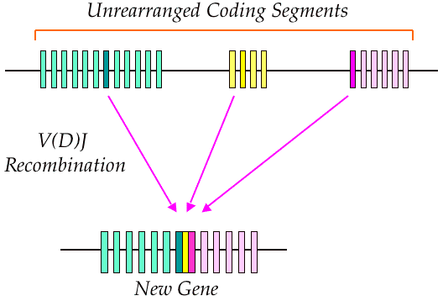
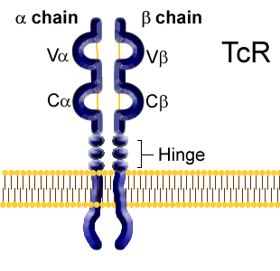
TCR rearrangement
Vα
Vβ
Dβ
Jα
Jβ

Slide 3
T Cell Receptor Gene Segments
Antigen Presenting Cell
HLA Molecule
Peptide
Vα
Jα
Vβ
Dβ
Jβ
Chr. 14
Chr. 6

Slide 4
T cell Recognition of Antigen on an APC
Antigen
Endocytosis
CD4⁺
T cell
APC
T Cell Receptor
Trimolecular Complex
Peptide
MHC II

Slide 5
The Trimolecular Complex NOD MOUSE
TCR
PEPTIDE
INS B:9-23
MHC

Slide 6
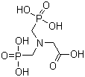
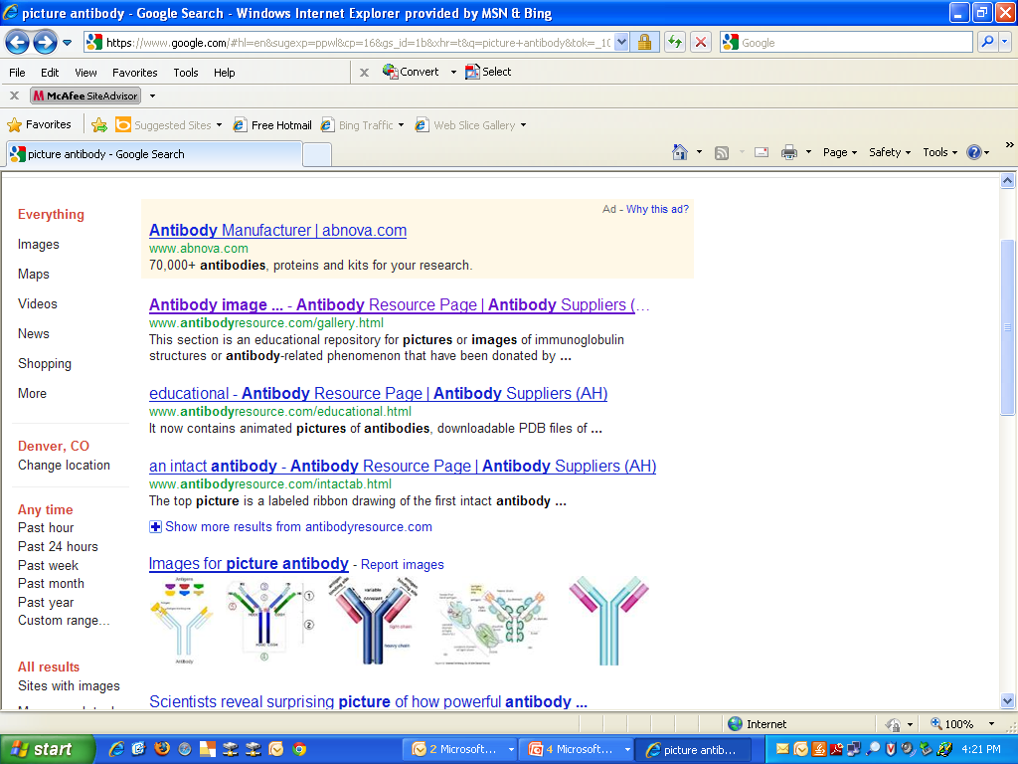
MHC
B:9-23
TCR
TCR
Liu et al Diabetes 2012
Zhang et al, J. Diabetes 2011
Michels et al, J. Immunol 2011
MHC
B:9-23
MHC
TCR
B:9-23
Deletion of T cells expressing
specific TCR alpha or
TCR beta genes
Antibody binds to MHC/peptide
complex and blocks it
from interacting with TCR
Small molecule prevents from
binding/dislodges the B:9-23
peptide from MHC
Interfering with formation of the trimolecular recognition complex

Slide 7
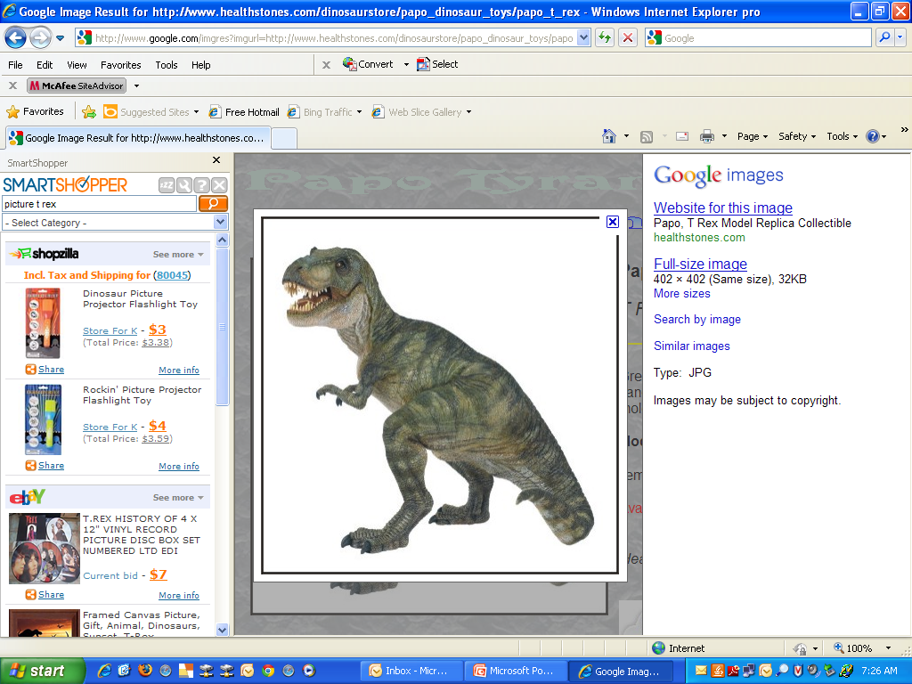
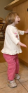
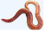
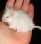
*

Slide 8
“Stages” in Development of Type 1A Diabetes
(?Precipitating Event)
Genetic
Predisposition
Overt
immunologic
abnormalities
Progressive
loss insulin
release
Beta cell mass
Normal insulin
release
Overt
diabetes
Glucose
normal
C-peptide
present
Minimal
C-peptide
Age (years)
Eisenbarth, 2012
Notes:
8
8

Slide 9
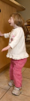
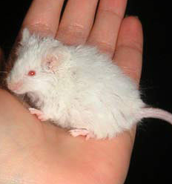
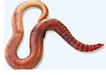

Slide 10
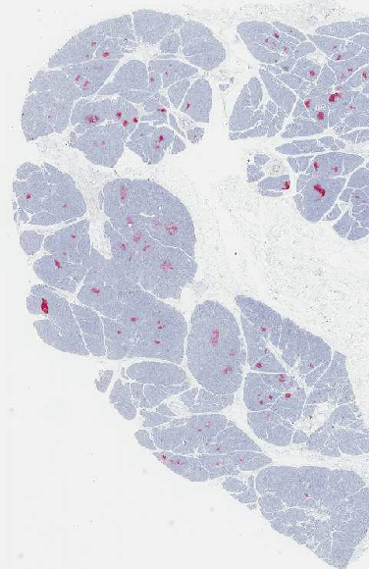
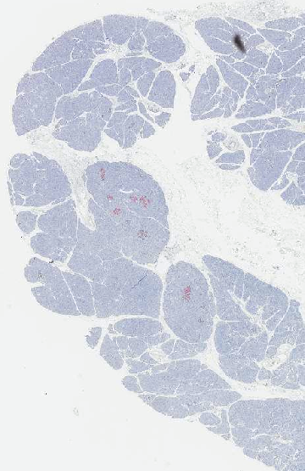
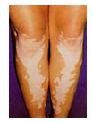
nPOD 6052-02 Tail: 12 yo 1 year diabetes
-Lobular Pseudoatrophic Islets
Glucagon/anti-CD3 Staining
Insulin and Ki67 Staining

Slide 11
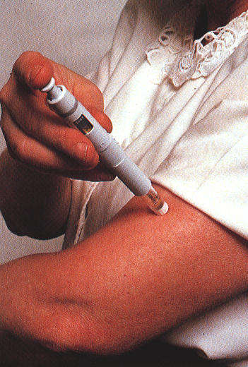
Type 1 diabetes
Anti-insulin: health
No cure; therapy is insulin for life; physiologic glycaemic control never achieved
Anti-insulin: disease
Excess morbidity and mortality
Incidence increasing by ~5% every 5 years; costs ~£1 billion of UK NHS budget
Peakman

Slide 12
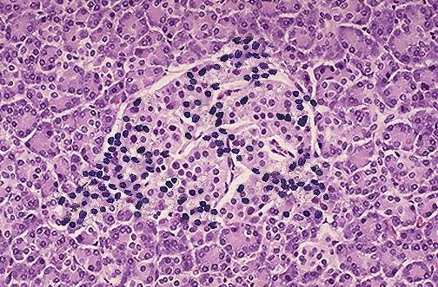
Type 1 diabetes is T cell mediated
Infiltrating CD4+, CD8+ T cells
Anti-T cell therapies are effective
Islet cell autoantibodies ≠ disease
CD4
T-cell
CD8
T-cell
CD4
Treg
TCR
Epitope
HLA II
HLA I
APC
Islet
autoantigen
Peakman

Slide 13
The Immune System
Innate
Rapid Microbial Defense
Adaptive Immune System Activation
Acquired (Adaptive)
Long-lived Microbial Defense
Neoplasm surveillance
Autoimmunity, Transplantation Rejection & Atopy
BDC

Slide 14
The Innate Immune System
Antimicrobial Peptides (e.g., Defensins, Cathelicidins)
Phagocytes (Macrophages, Neutrophils, Monocytes, Dendritic Cells)
Pattern Recognition Receptors
Alternative Complement System
NK Cells
B1B Cells*
* Aspects of both the innate and adaptive immune system
BDC

Slide 15
Selected Pattern Recognition Receptors: Toll-like Receptors
TLR: | Selected Ligands: | Role in Immunity: | Localization:
TLR1 | PGN, Zymosan, Lipoproteins | Antifungal & Antibacterial | Dendritic Cells, Macrophages, T Cells, B Cells, Epithelium
TLR2
TLR6
TLR4 | LPS | Antibacterial
TLR5 | Flagellin
TLR11 | ?
TLR9 | CpG | Antibacterial & Antiviral
TLR3 | dsRNA | Antiviral
TLR7 | ssRNA
TLR8 | ssRNA
TLR10 | ? | ?

Slide 16
Selected Pattern Recognition Receptors: Other Families

Slide 18
The Adaptive Immune System
Cell-mediated Immunity (Cytotoxicity)
  T cells
    CD4+ (Th1 & Th2)
    CD8+ (Tc1 & Tc2)
Humoral Immunity (Antibody production)
  B Cells
BDC

Slide 19
Th1 and Th2 CD4+ T Cells
Th1
IL-12 induces differentiation
Cytokine Production:
Interferon-γ
Interleukin-2
Intracellular Pathogens
Macrophage Activation
Delayed Type Hypersensitivity
Th2
IL-4 induces differentiation
Cytokine Production:
Interleukin-4
Interleukin-5
Interleukin-13
Extracellular Pathogens
B Cell activation & IgE
Eosinophil responses
Immediate Type Hypersensitivity
BDC

Slide 20
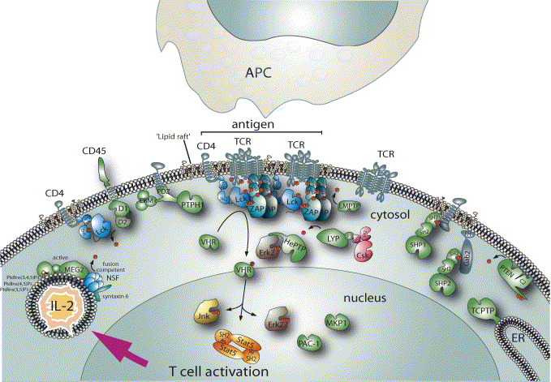
T cell signaling molecules and autoimmunity
Human T1D loci (Ref1)
MHC : λs ≈ 3
Insulin : odds 1.9
CTLA4 : odds 1.2
PTPN22 odds 1.7
Cblb : Komeda rat
(Yokoi N, Nat Genet, 2002)
Pten: Cre-loxP knock-out
(Suzuki A, Immunity, 2001)
Zap70: Sakaguchi mice
(Sakaguchi N, Nature, 2003)
(Mustelin T, et al. Mol Immunol. 2004)
Concannon P et al. Diabetes. 2005 Oct;54(10):2995-3001.
H. Ueda

Slide 21
B and T Lymphocyte Antigen Receptors
V_{H}
V_{H}
Vβ
Vα
V_{L}
C_{H1}
C_{H1}
V_{L}
γ
ε
ε
δ
ζ
ζ
Cβ
Cα
C_{L}
C_{L}
C_{H2}
C_{H2}
Igα/Ιgβ
C_{H3}
C_{H3}
Igα/Ιgβ
fyn
lck
Zap 70
Blk, Fyn or Lyn
2 light chains (λ or κ)
2 heavy chains (5 isotypes: IgG, M, A, D, E)
2 Binding sites (Divalent)
Secreted into circulation
Binds Soluble Antigen
2 Chains α/β (95%) or γ/δ (5%)
1 Binding site (Monovalent)
Membrane Bound, Not Secreted
Binds Antigen Complexed with MHC
BDC

Slide 22
HLA
J. Noble
Human Leukocyte Antigen
human MHC
cell-surface proteins
important in self vs. nonself distinction
present peptide antigens to T cells
CLASS I: A,B,C
CLASS II: DR,DQ,DP

Slide 23
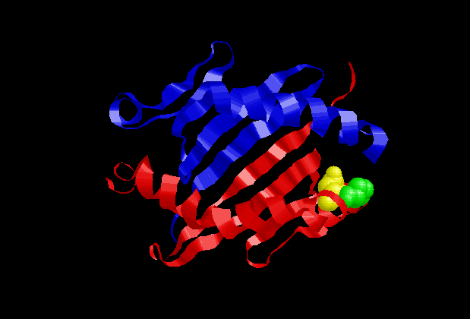
DQB1*0402
α -chain
Leu56β
β-chain
Asp57β
BDC
BDC

Slide 24
Hahn, Wucherpfenning et al. Nature Immunology 6:490-496, 2005
Topology of Self-peptide/MHC Binding by Ob.1A12 TCR
Autoimmune (MBP Peptide+DR2)
Anti-viral (HA Peptide+DR1)
Ob.1A12
HA1.7
Red: TCRβ
Yellow: TCRα

Slide 25
Hahn, Wucherpfenning et al. Nature Immunology 6:490-496, 2005
Ob.1A12 HA1.7
Anti-viral (HA Peptide+DR1)
Autoimmune (MBP Peptide+DR2)
Red: TCRβ
Yellow: TCRα

Slide 26
The Human Leukocyte Antigen Complex (6p21.31)
Class III
Class II (1.1 Mb)
(0.7Mb)
Class I (2.2Mb)
DP DQ DR B C A
Centromere
Telomere
Frequent
Recombination
Class I-like genes
and pseudogenes
Complement
and Cytokines
Recombination
is Rare
Recombination
is Rare
BDC

Slide 27
HLA Class I and II Molecules Have a Distinct Structure and Function
Binds 8-10mers
Expressed on most
Nucleated cells
Presents Cytosolic
Proteins to CD8+ T cells
Binds 13-25mers
Expressed on APCs,
Macs, B cells, activated
T cells
Presents Vesicular
Proteins to CD4+ T cells
α1
α2
α1
β1
β2
α3
α2
β2
Class I Class II
BDC

Slide 28
Cis and Trans- Class II Dimerization
DQA1 DQB1
0501 0201
cis
Maternal
Paternal
DQA1*0501/DQB1*0201
cis
0301 0302
trans
DQA1*0301/DQB1*0302
DQA1*0301/DQB1*0201
DQA1*0501/DQB1*0302
BDC

Slide 29
HLA-Peptide: TCR
α2 Helix
NH3+
α1 Helix
TCR
alpha
CDR1
CDR3
CDR2
CDR2
CDR3
TCR
beta
CDR1
BDC
COO-

Slide 30
“Tetramer” for T Cell Analysis
DQ
PEPTIDE
Avidin
DQ
DQ
DQ
BDC

Slide 32
T cell Recognition of Antigen on an APC
Antigen
Endocytosis
CD4⁺
T cell
APC
T Cell Receptor
Peptide
MHC II

Slide 33
T cell Activation by an Activated APC
IL-1
IL-6
IL-12
IL-12 Receptor
CD28
CD4⁺
T cell
“Signal 3”
B7
LPS
“Signal 2”
T Cell Receptor
TLR4
“Signal 1”
Peptide
Signal 1: Specificity
Signal 2: Activation
Signal 3: Differentiation
MHC II
Antigen Presenting Cell (APC)

Slide 34
The 2-Signal Model of Lymphocyte Activation
Absence of Signal 2
APC
T Cell
TCR
MHC
Tolerance
Clonal Anergy or Deletion
Signal 1 + Signal 2
CD28
B7
APC
T Cell
TCR
MHC
cytokines
Activation
BDC

Slide 35
APC and T cell Interactions
B7 (CD80/86)
CTLA-4
↓Activation
B7 (CD80/86)
CD28
↑Activation
CD4⁺ T Cell
MHC II
TCR
Recognition
APC
CD58 (LFA-3)
CD2
Adhesion
↑Activation
CD40
CD40L

Slide 36
Molecular Interactions of Helper T Cells and APC
CD4+ T Cell
CTLA-4
CD28
p56 lck
CD3
CD2
γ
δ
ε
ζ
ζ
η
η
CD40L
C
C
TCR
α
β
CD45
LFA-1
V
α
V
β
VLA-1
peptide
B7
B7
LFA-3
CD4
MHC II
ICAM-1
Collagen
CD80/CD86
CD40
APC/ B cell
L. Chess 2002

Slide 37
T cell activation is regulated by signals derived from the TCR /CD3/CD4 complex and the CD40L and CD28/CTLA-4 co-stimulatory molecules
CD4+ T Cell
Co-stimulatory signals
Antigen specific TCR signals
(- ) / [+]
lck
CD3
γ
δ
ε
ζ
ζ
η
η
CD28/
CTLA-4
C
α
C
β
α,β TCR
V
α
V
β
CD40L
Peptide antigen
CD40
CD4
MHC class II
CD80 (B7.1)/
CD86 (B7.2)
[+]
signal
Antigen Presenting Cell (APC)
L. Chess 2002

Slide 38
TCR signaling
TCR
CD4
CD45
CD28
Zap70
Lck
Lck
Fyn
Tec
Shc
PTK
PLCγ1
Grb2
PIP₂
SOS
(PMA)
(ION)
Ras
IP₃ + DAG
Ca⁺⁺
PKC
calcineurin
MAPK
NFκB
NFAT activation
Fathman

Slide 39
T cell activation induces expression of functional T cell surface molecules
Induction and activation of B cells APCs
MHC/peptide
Activated
CD4+ T cell
Late Activated
CD4+ T cell
CD40L
TCR
TCR
TCR
Resting
CD4+ T cell
CD25
APC
(+)
(-)
Qa-1/Vβ
VLA-1
Collagen
TCR
(anti-Qa-1/Vβ)
Migration of sites of inflammation
Activated
CD8+ T cell
Regulatory
CD8+ T cell
Down-regulation of
Activated CD4+ T Cells
L. Chess 2002

Slide 40
Immunological tolerance
Definition:
  specific immune unresponsiveness to an antigen that is induced by exposure of lymphocytes to that antigen (tolerogen vs immunogen)
Significance:
  All individuals should be tolerant of their own
  antigens (self-tolerance); breakdown -->autoimmunity
  The induction of tolerance could be exploited to treat autoimmune diseases
  Mechanisms of tolerance must first be understood
Fathman

Slide 41
Mechanisms of unresponsiveness to self antigens
Central tolerance
  Immature self-reactive T lymphocytes that recognize self antigens in the thymus undergo negative selection (deletion)
Peripheral tolerance
  Mature self-reactive T lymphocytes that escape central tolerance and recognize self antigens in peripheral tissues can be inactivated (anergy), killed (deletion) or regulated (suppressed)
“Clonal ignorance”
  Mature self-reactive lymphocytes do not respond to self antigens
  in non-inflamed settings
Fathman

Slide 42
The Control of Activated CD4+ T Cells by Regulatory T cells
NKT cells/ CD4+CD25+ cells
CD4+CD25- cells
Apoptosis
(- )
TH1 CD4+ cells
peptide/APC
IL-12/
IFN-γ
(- )
IL-4
IL-10
IFN-γ
(- )
Resting CD4 T cells
Activated CD4 T cells
(- )
TH2 CD4+ cells
Regulatory immunity
CD4/CD8 interactions
CD8 or CD4 suppressor effector
CD8 or CD4 suppressor
precursor
L. Chess 2002

Slide 43
Regulatory T Cell Subsets

Slide 44
Regulatory T Cells in Autoimmunity
BDC
Roncarolo et al. Curr Opinion Immunol 2000

Slide 45
XPID: X-linked Polyendocrinopathy, Immune dysfunction and Diarrhea
Foxp3 Gene Essential CD4-CD25 T Reg
XLAAD: Autoimmunity Allergic Dysregulation
Defect in scurfin protein (gene = Foxp3/JM2)
or “scurfy mouse”
Immunopathogenesis relates to a deficiency of T regulatory cells
-Scurfy x Nude: No Autoimmunity
-CD4+ T cells into Nude: Disease
-Bone Marrow into irradiated: No Disease
-Mixed Chimera: No Disease
BDC

Slide 46
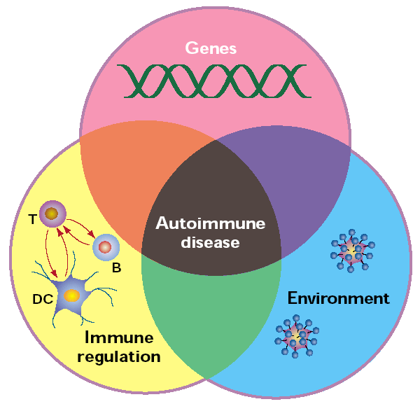
Requirements for the development of an autoimmune disease
Nature Immunology (9): 759-761 (2001)
Fathman

Slide 47
Immunopathophysiology of Diabetes
Dendritic cell/
APC
Activated TH1 CD4+ T Cell
CD4+ Cell
(TH0 )
CD2
DR3, DR4,,DQ8/insulin peptide
IL-12
CD40L
α,β, TCR
IFN-γ
CD40
IL-4
Macrophage/dendritic cell
CD4+ Cell
(TH2 )
FasL
perforin
Fc R
CD40L
CD8+ CTL
IL-1, TNF, LT, NO, PGE-2
IL-4
CD40L
B Cell
?anti-insulin, GAD ab anti-Mog
β cell death
?Antibody mediated injury
β islet cells
L. Chess 2002

Slide 48
Induction of CD4+ TH1 mediated autoimmunity:
A paradigm for the pathogenesis of rheumatoid arthritis, multiple sclerosis and type I diabetes
(1) expansion of CD4+, autoreactive TH1 cells specific for autoantigens
(2) migration and infiltration of these self reactive CD4+ TH1 cells into tissues and induction of inflammation and autoimmunity
(3) induction of regulatory cells which control the growth and activation of the pathogenic autoreactive repertoire of CD4+ T cells
MHC/self-peptide
CD4
CD4
MHC/Vβ
TCR Vβx
TCR Vβx
CD4+ Vβx T cell
APC
Activated autoreactive CD4+
TCR Vβx TH1 cell
L. Chess 2002

Slide 49
1984:Subset Participants Immunology in Diabetes Rome

