Slide 1
Chapter 10
Humoral Autoimmunity

Slide 2
LONG TERM PRE-DM WITH MULTIPLE AUTOANTIBODIES
36336-0 DAISY Study
LEVEL Autoantibodies
Diabetes Onset

Slide 3
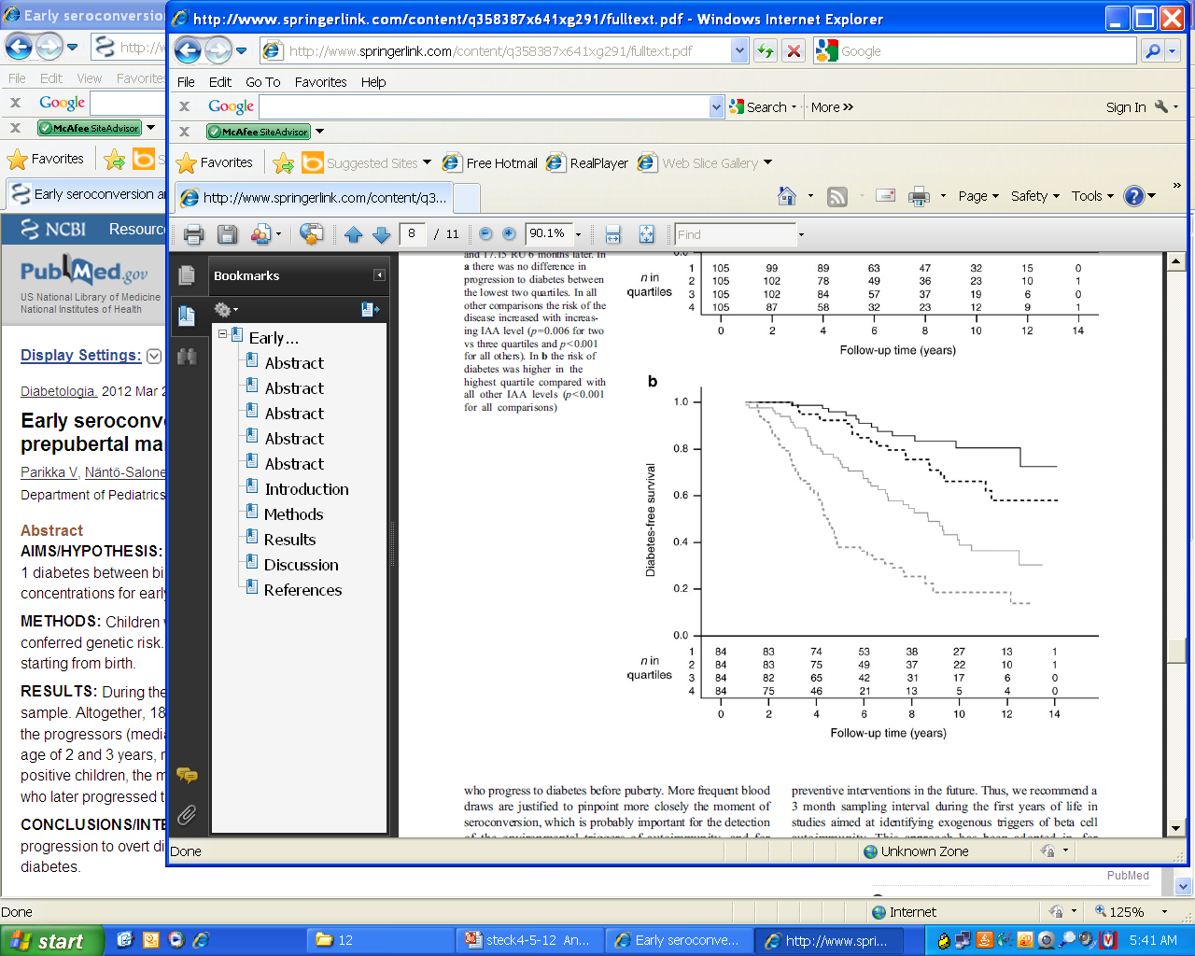
DIPP Populations Study: Quartile Levels Insulin Autoantibodies (6 month post first IAA) and progression to Diabetes
Parrika et al Diabetologia 2012

Slide 4
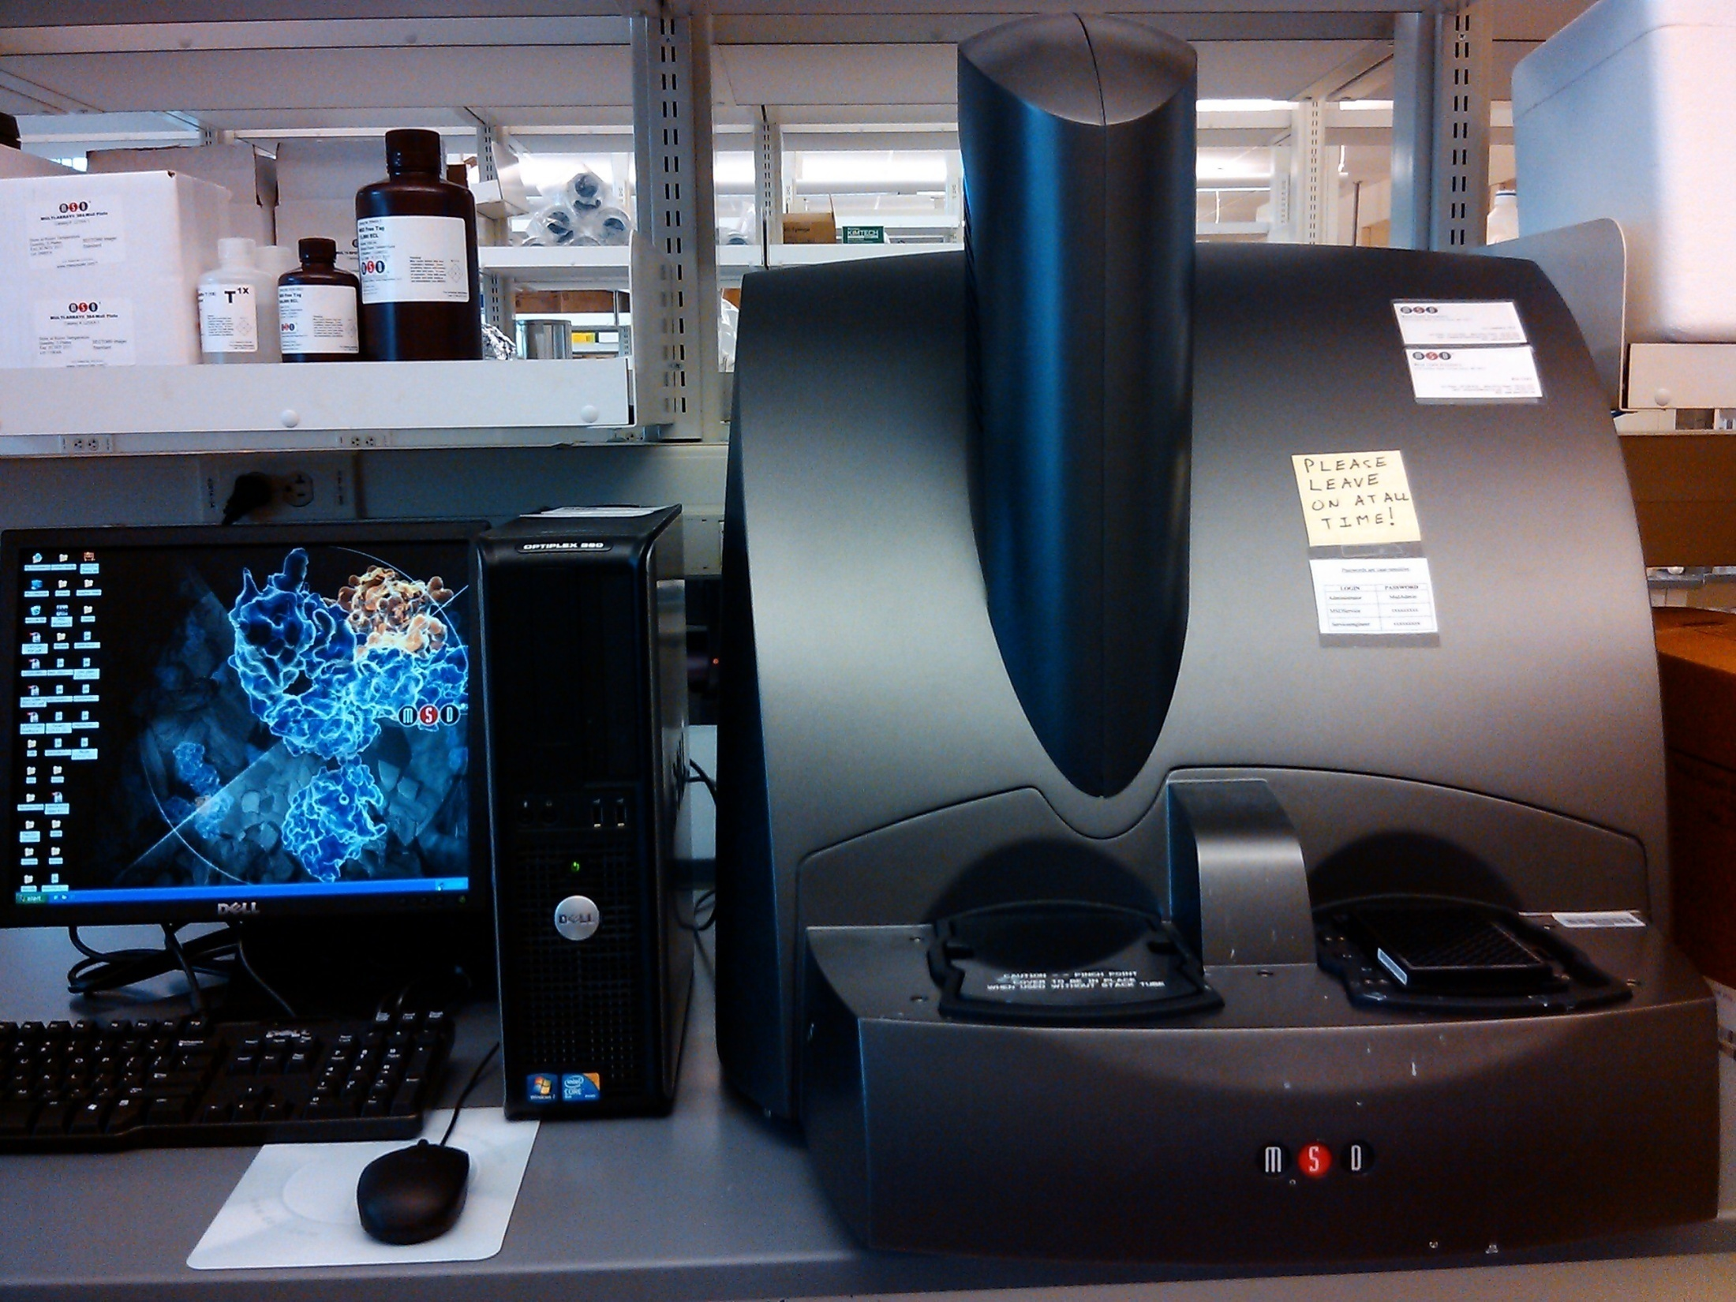
MSD
ELECTROCHEMILUMINESCENT
READER

Slide 5
Non-Radioactive Electrochemiluminescent Assay for Insulin Autoantibodies
Insulin
Autoantibody
Sulfo-TAG
Labeled Proinsulin
Biotin
Labeled Proinsulin
Streptavidin
Coated plate
Yu et al Diabetes 61:179, 2012

Slide 6
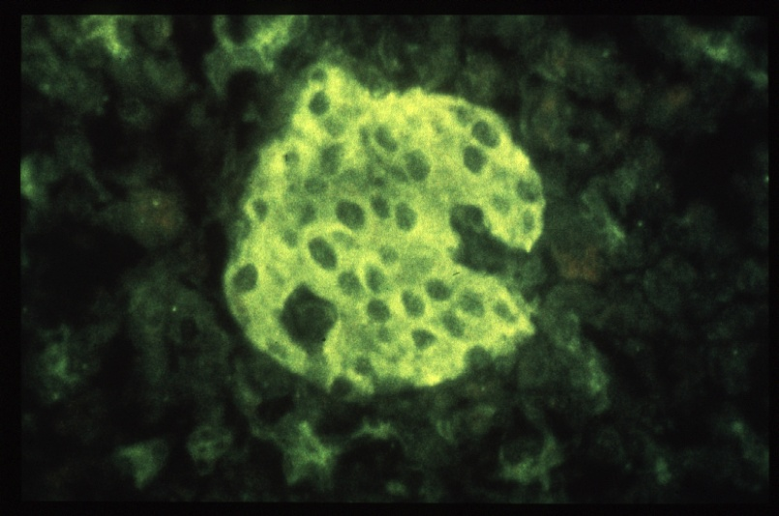
Major Islet Autoantigens
Insulin
autoantibodies
ICA
?
ZnT8
IA-2 (ICA512BDC)
GAA
(GAD₆₅)
IAA

Slide 7
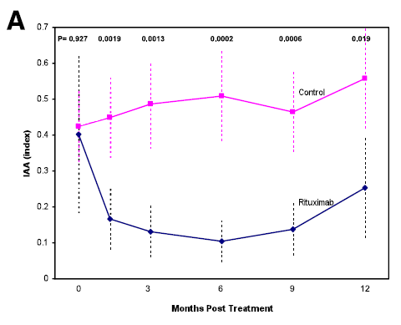
Rituximab Selectively Suppresses Specific Islet Antibodies
Trialnet-Yu et al Diabetes 2011

Slide 8
Islet autoantibodies can discriminate maturity-onset diabetes of the young (MODY) from Type 1 diabetes.
McDonald TJ, Colclough K, Brown R, Shields B, Shepherd M, Bingley P, Williams A, Hattersley AT, Ellard S.
Diabet Med 2011
GAD and IA-2 measured:
MODY (GCK=227, HNF1A=229, HNF4A=52 patients
5/508 (1%) positive, all GAD only
Type 1 (n=98)
82% Positive

Slide 9
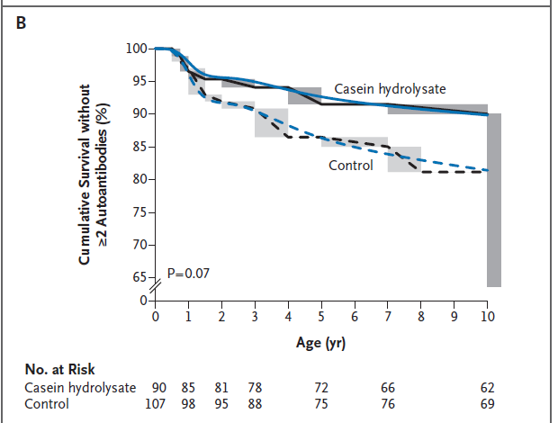
Dietary Intervention in Infancy and Later Signs of Beta-Cell Autoimmunity
Knip et al NEJM 2010

Slide 10
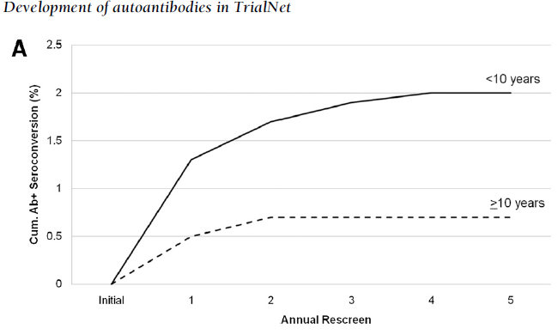
Development of Autoantibodies in the
TrialNet Natural History Study
Vehik et al Diabetes Care 2011

Slide 11
Genetic Analysis of Adult-Onset Autoimmune Diabetes
Joanna M.M. Howson,1 Silke Rosinger,2 Deborah J. Smyth,1 Bernhard O. Boehm,2 the ADBW-END Study Group,* and John A. Todd1
Diabetes 2011
DR3 associated with GAD antibody positivity of adults with Type 1 diabetes but absence of IA-2 autoantibodies.
DR4 associated with IA-2 positivity and younger age of onset as was DR3/4 heterozygotes.

Slide 12
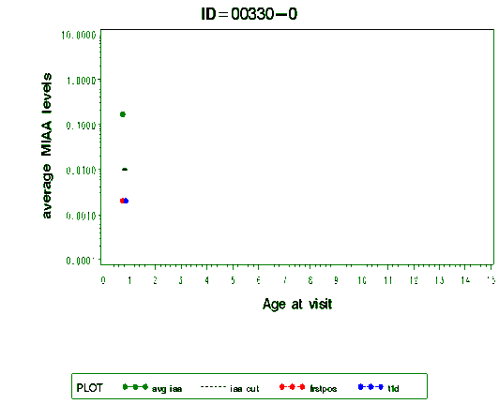
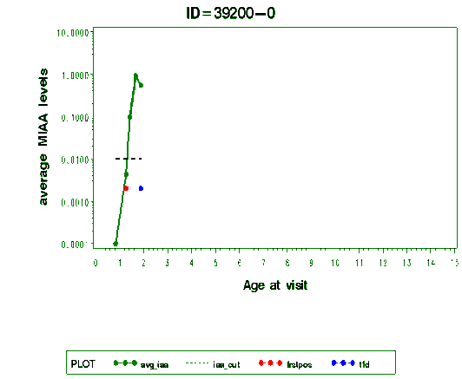
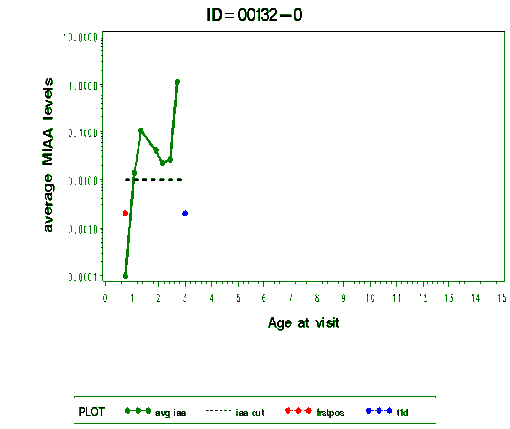
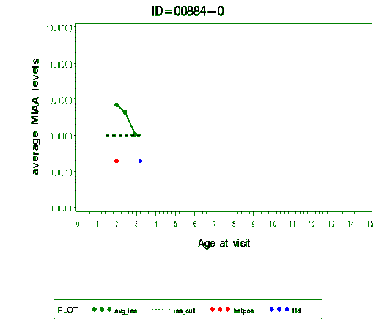
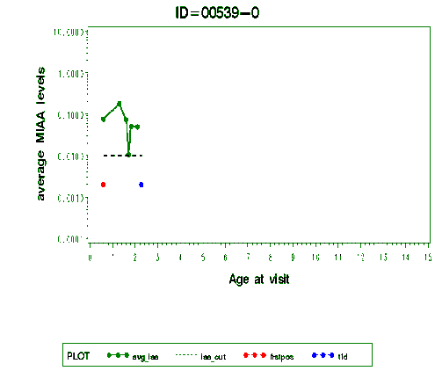
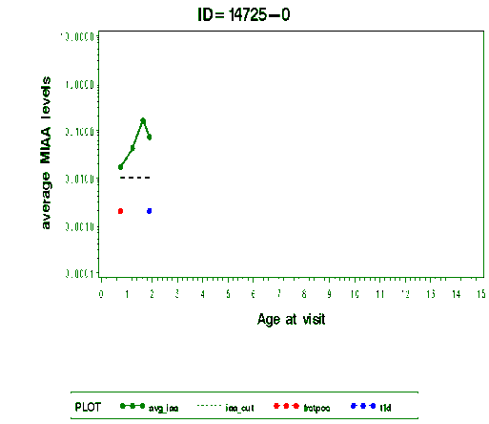
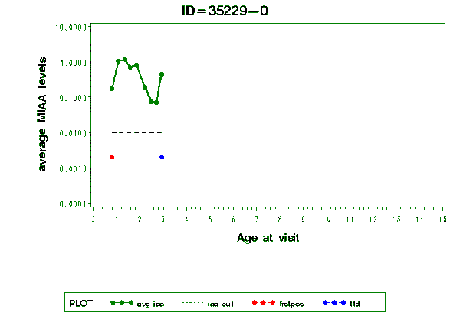
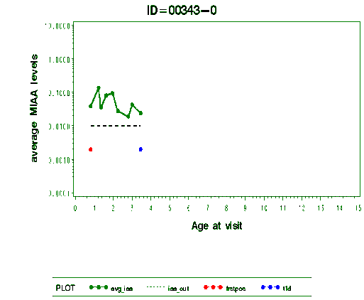
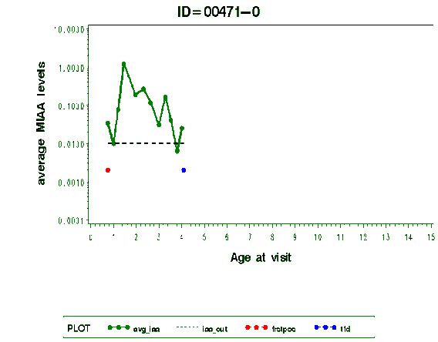
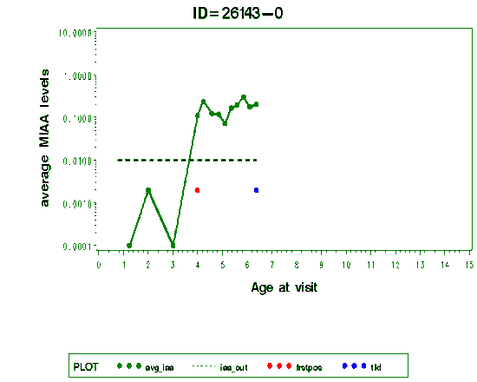
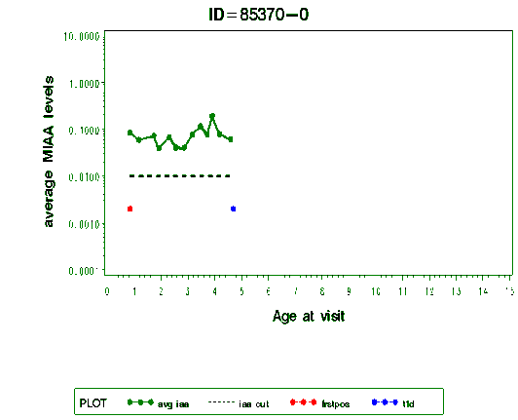
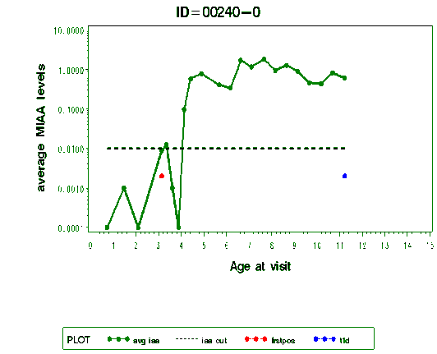
HIGH LEVELS INSULIN AUTOANTIBODIES DAISY STUDY PROGRESSION TO DM
FIRST DOT: AGE ANY ANTIBODY APPEARED/ SECOND: DM AGE
Notes:
12

Slide 13
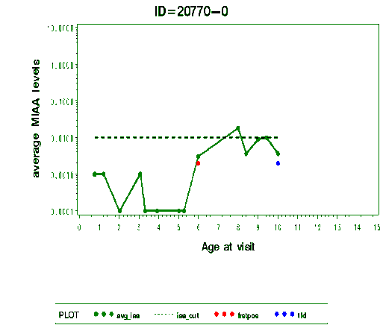
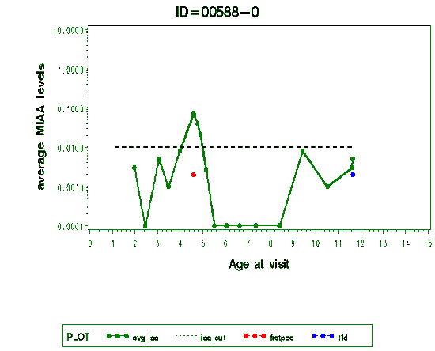
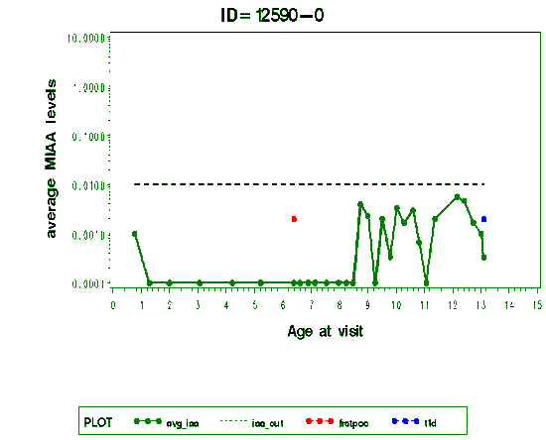
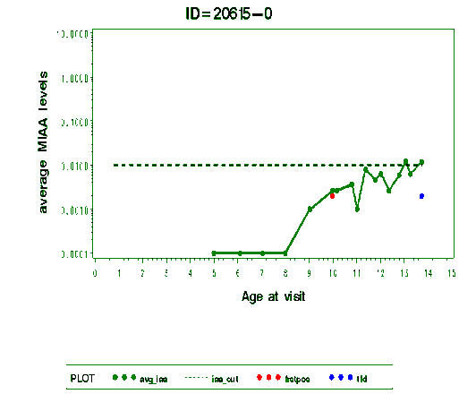
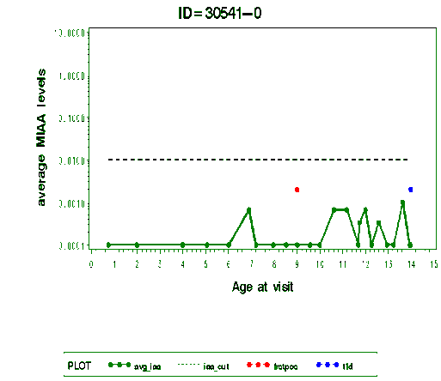
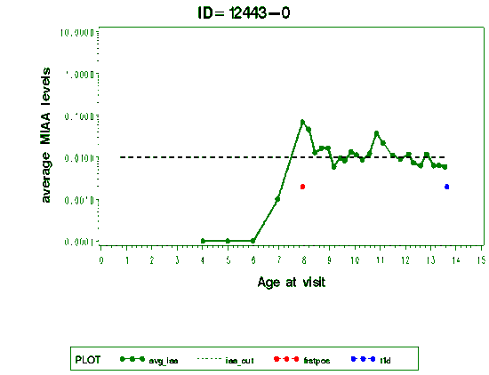
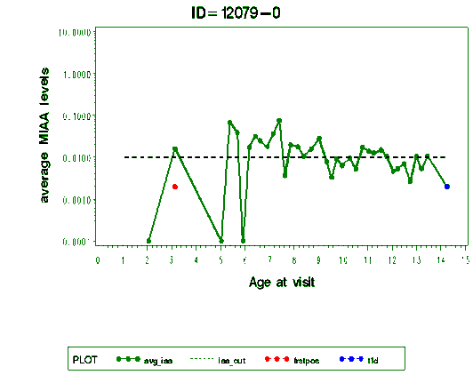
Steck et al Diabetes Care 2011
Age of Islet Autoantibody Appearance and Mean Levels of Insulin, but Not GAD or IA-2 Autoantibodies, Predict Age of Diagnosis of Type 1 Diabetes
Diabetes Autoimmunity Study in the Young
LOW LEVELS INSULIN AUTOANTIBODIES DAISY STUDY PROGRESSION TO DM
FIRST DOT: AGE ANY ANTIBODY APPEARED/ SECOND: DM AGE
Notes:
13

Slide 14
R2=.37 P<.0001
Steck et al
Diabetes Care
2011
Steck… Diabetes Care 2011
Notes:
14

Slide 15
Steck… Diabetes Care 2011
Notes:
15

Slide 16
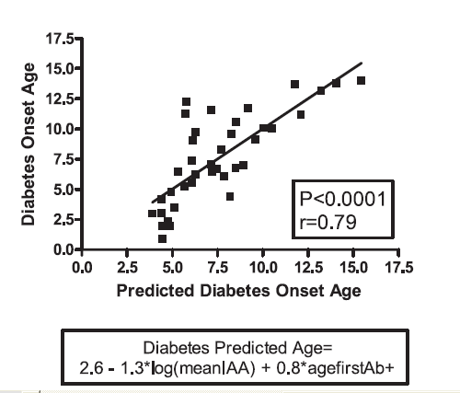
Steck et al Diabetes Care 2011
Age of Islet Autoantibody Appearance and Mean Levels of Insulin, but Not GAD or IA-2 Autoantibodies, Predict Age of Diagnosis of Type 1 Diabetes
Diabetes Autoimmunity Study in the Young

Slide 17
Mean Insulin AutoAb levels by INS genotypes
Steck et al
Diabetes Care 2011

Slide 18
Enhancing Prediction Diabetes with ZnT8 Autoantibody Determination
N=88 Children DAISY prospective study
+ Only one AutoAb (of GAD/IA-2/Insulin)
>3 Yrs age and >1 year Follow-up
ZnT8 Antibodies measured first Ab+ sample
14% also ZnT8 Antibody Positive (Thus >=2Ab)
ZnT8+ 37% (7/19) Progressed to Diabetes
ZnT8- 7% (5/69, P<.003) Progressed
Wenzlau et al PNAS 104:17040-17045, 2007

Slide 19
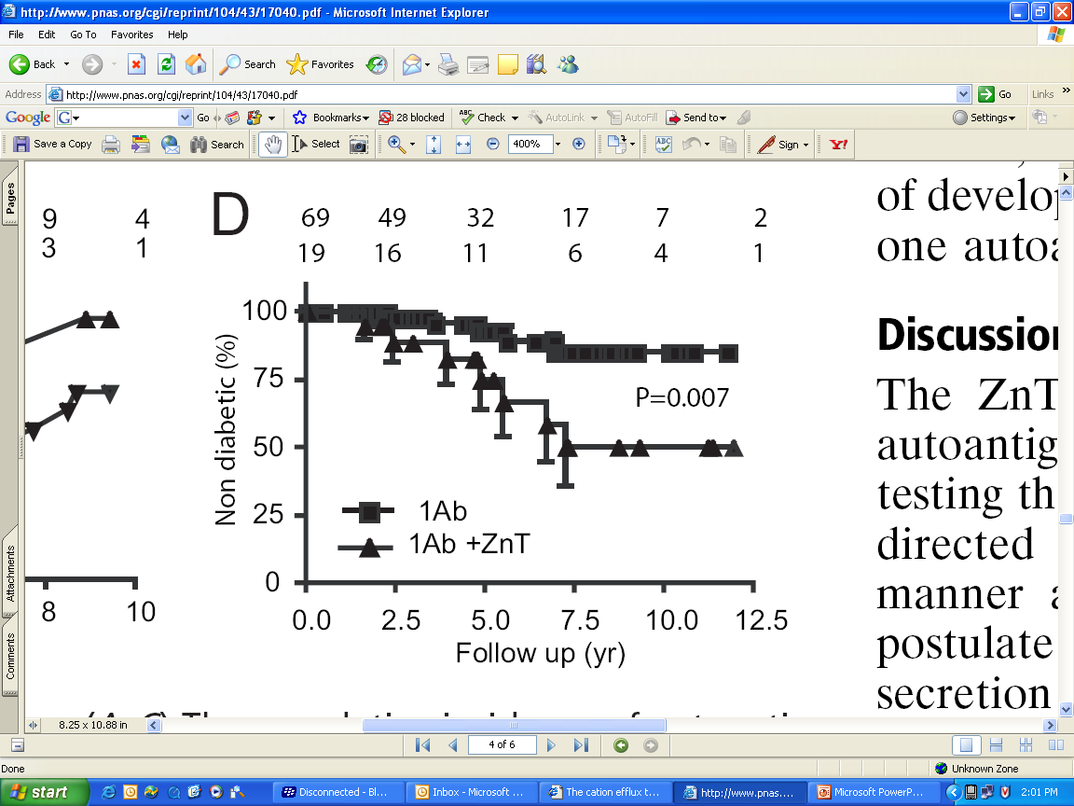
DAISY subjects with only 1 Ab (GAD/IA-2/Insulin) vs + ZnT8 Autoantibodies
Wenzlau PNAS 2007

Slide 20
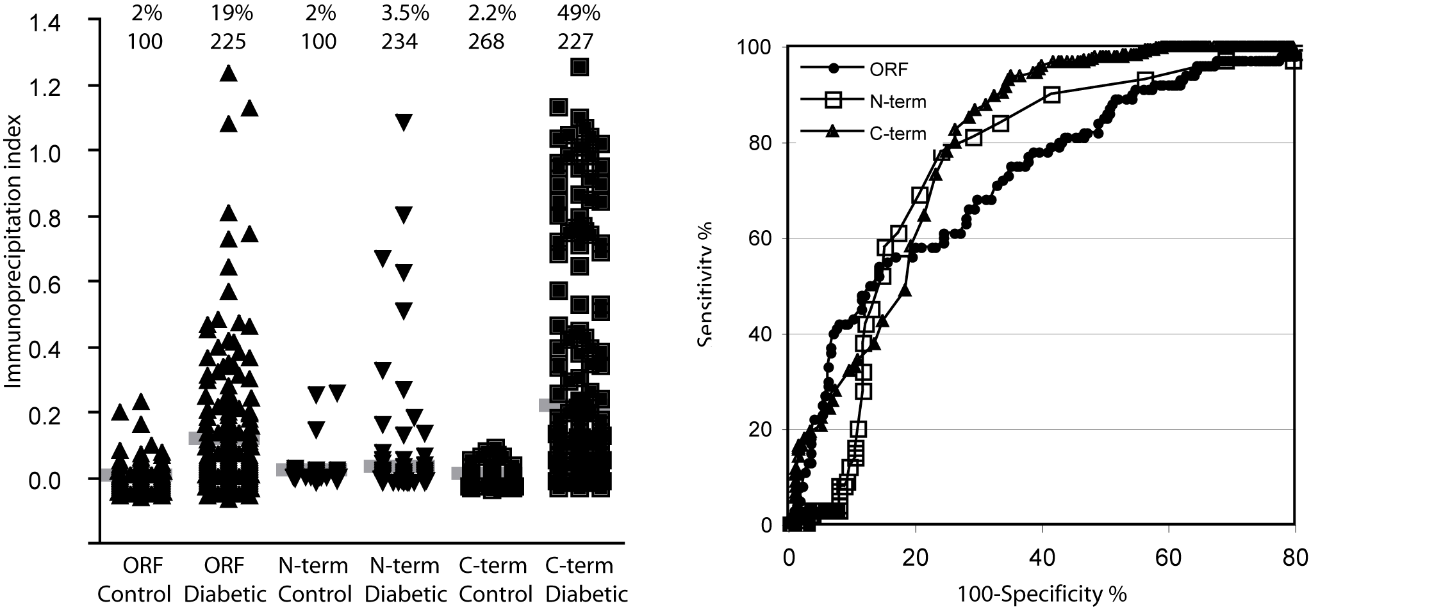
Receiver Operator Characteristics of the ZnT8 antibody assays
J.M. Wenzlau, H.W. Davidson, and J.C. Hutton
Notes:
Data were derived from a combination of new onset patients at the Barbara Davis Center and a sample set provided by DASP. The combination covered individuals ranging from 1.5 years to 59 years of age at onset. Cutoffs were determined from the 3SD limited of a group of 16 control sera corresponding. ROC plots were generated by comparison of the control and diabetic group in each casew

Slide 21
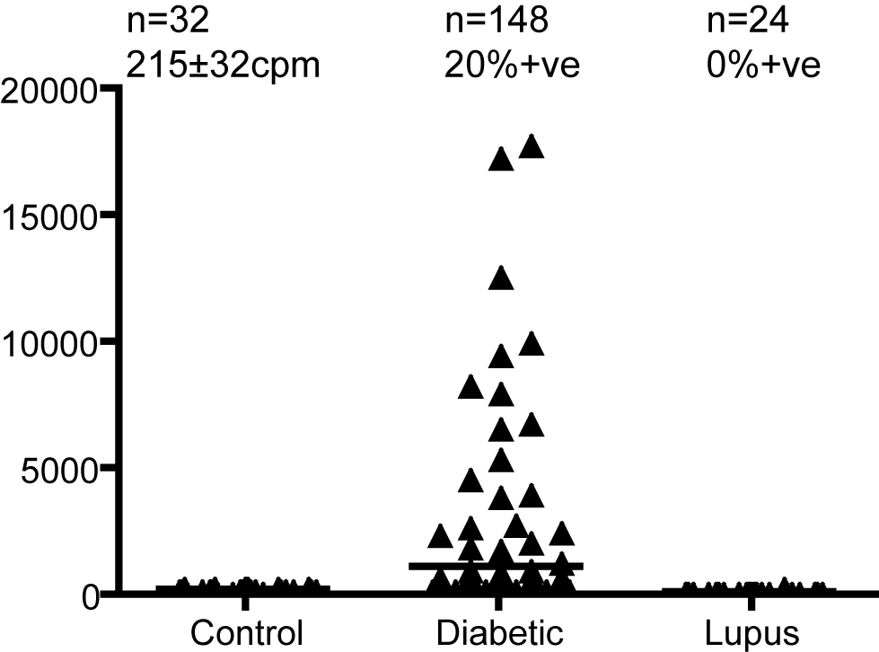
ZnT8 detects autoantibodies in patients who are negative
for ICA and gold standard biochemical antibodies.
J.M. Wenzlau, H.W. Davidson, and J.C. Hutton
Notes:
ZnT8 picks up patients who are ICA antibody negative
The original gold standard for detection of diabetic autoantibodies is ICA (islet cytoplasmic antibodies) a complicated, tedious and relatively subjective assay that entails exposure of histological pancreatic sections from blood group 0 human subjects to sera followed by incubation with a fluorescently labeled second antibody and microscopic evaluation by a trained observer. It has not been fully replaced by the 3 biochemical antibody assay (Insulin GAD and IA2) since there are individuals who are ICA+ve yet biochemical antibody negative. Thus for the large Diabetes Prevention Trial 1 involving more than 60000 subjects ICA was used as the procedure to define autoimmunity in a population of high risk first degree relatives of T1D patients.
Analysis of 30 new onset patient sera who were ICA+ve but Insulin.GAD and IA2 negative showed that #(#%) were reactive to ZnT8 C-term probe suggesting that ZnT8 may be a component of the antibodies detected in the ICA assay. Even more remarkable is the finding that 30 (20.3%) of samples from individuals who were negative for ICA as well as insulin. GAD and IA2 tested positive for ZnT8 antibodies. This suggests that the epitope detected the C-term probe is perhaps cryptic in the ORF molecule, a conclusion that was born out in subsequent studies.
There is the potential that the reactivity to ZnT8 might related to autoimmunity but specifically to diabetes. A series of 24 samples of individuals who tested positive for anti DNA antibodies were negative in the ZnT8 autoantibody assay.

Slide 22
Value of 4 antibodies
40
40
30
26
20
13
10
9
0
0 1
1 2
2 3
3 4
Number of Autoantibodies
Sera from 223 newly diabetic individuals were assayed for reactivity to insulin, GAD65, and IA-2 ± ZnT8. Nine individuals were negative for insulin, IA-2, and GAD65 but positive for ZnT8 autoantibodies, increasing the percentage of sera positive for at least 1 autoantibody from 94% to 98%. In addition 26 individuals (11.7%) were re-classified from single to multiple autoantibody positivity on the basis of ZnT8 autoreactivity.
J.M. Wenzlau, H.W. Davidson, and J.C. Hutton
Notes:
The conclusion that measurement of ZnT8 autoantibodies in addition to insulin, GAD and IA2 has been made in the previous submission. At that time we only measured hCR reactivity which would have excluded Trp325 reactivity. The above graph further illustrates the concept as the change in detection rate (red with Znt8; blue without). The graph on the right shows the differential effect of adding the ZnT8 antibody measurement.

Slide 23
Pos = 63%
Follow up analysis (Wenzlau et al PNAS 104:17040, 2007) new onset patients
0.022
New Onsets
n=340
Controls
N=200

Slide 24
Znt8 Islet Autoantigen
ZnT8 cation efflux transporter (Slc30A8)
Approximately 60% of prediabetic and new onset patients express autoantibodies to C-terminus (amino acids 268-369) with fluid phase radioassay
Beta cell specific molecular target
Autoantibodies usually appear post mIAA and GAD65 AA in children followed from birth to type 1 diabetes.
Wenzlau et al PNAS 104:17040-17045, 2007

Slide 25
Stages in Development of Type 1 Diabetes
GENETICALLY AT RISK
MULTIPLE ANTIBODY POSITIVE
LOSS OF FIRST PHASE
INSULIN RESPONSE
BETA CELL MASS
GENETIC PREDISPOSITION
INSULITIS
BETA CELL INJURY
“PRE”-DIABETES
DIABETES
TIME
J. Skyler
NEWLY DIAGNOSED DIABETES

Slide 26
Diabetes Classification
Type 1A: Immune Mediated
Type 1B: Insulin deficient, no autoantibodies
Type 2: No Autoantibodies, Can initially be treated without insulin
Other Specific forms of Diabetes
Gestational Diabetes
BDC-July01

Slide 27
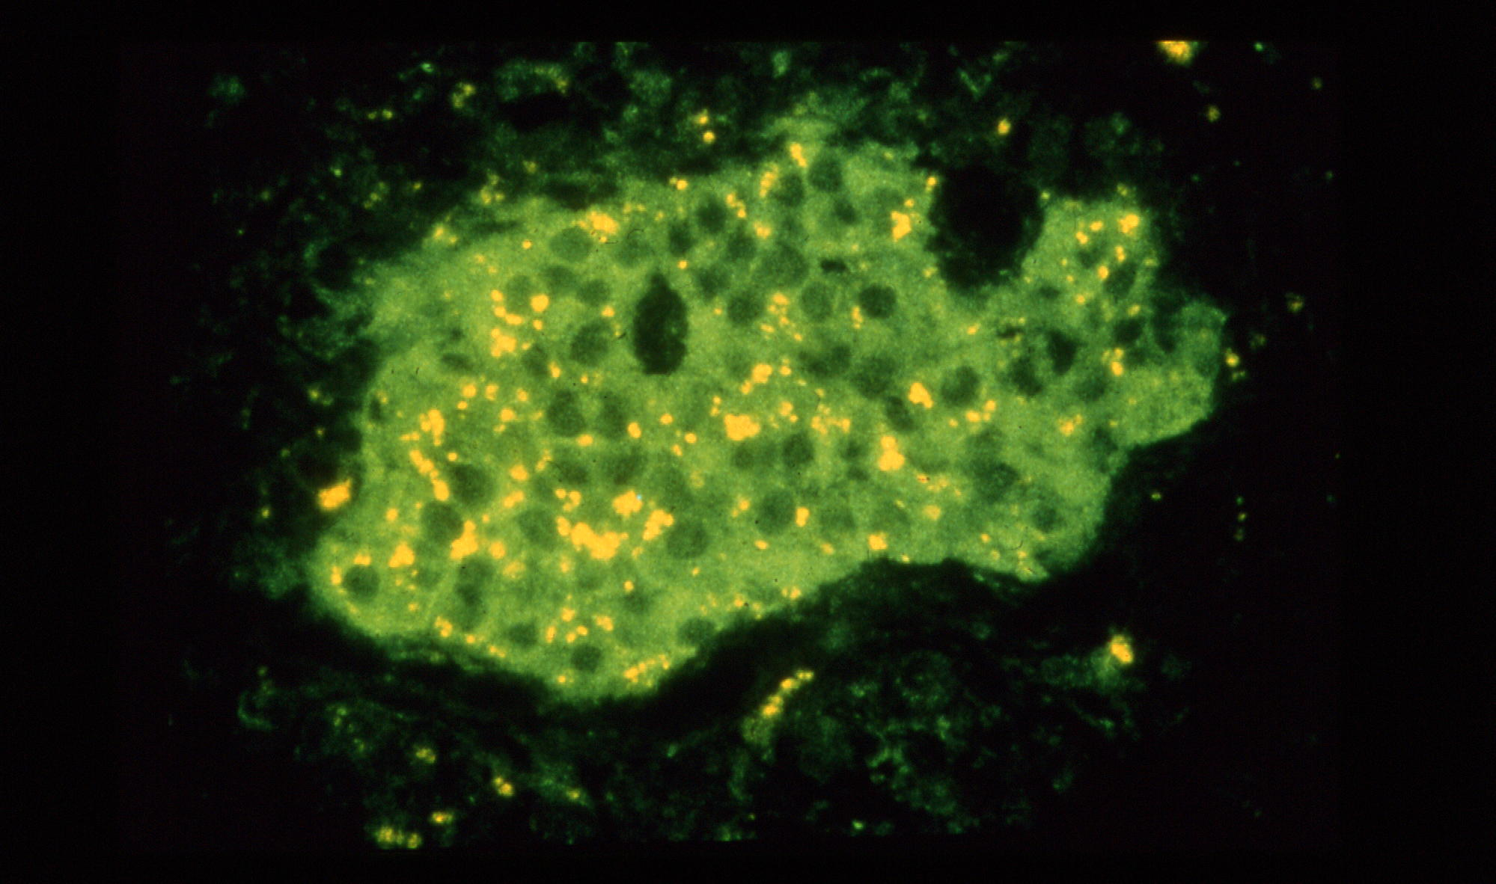
Cytoplasmic ICA kindly provided by the discoverer Franco Bottazzo

Slide 28
Inhibition of NOD Diabetes in Absence of Transplacental Antibodies (Ab)
Greeley et al, Nature Med 8:399, 2002

Slide 29
“Biochemical” Autoantibody Assays
Insulin
Glutamic Acid Decarboxylase
IA-2 (ICA512)
ZnT8
BDC

Slide 30
ROC= Receiver Operator Curve

Slide 33
ROC = Receiver Operator Curve

Slide 35
New Onset Children with Diabetes Seen at the Barbara Davis Center
BDC
Babu et al. 2001

Slide 36
Caveats of Autoantibody Testing
CAVEAT
SUGGESTION

Slide 37
Similar “rules” Other Autoimmune Disorders
Addison’s Disease(DQ8/DQ2 DRB1*0404) 21-hydroxylase Auotantibodies
30/2,100 type 1 pts (1.5%)
5/30 Addison’s first Test (1/400 patients)
Celiac Disease (DQ2 or DQ8)
Transglutaminase Autoantibodies
98/847 type 1 pts (12%)
15/20 Biopsies Positive/Estimate 1/20celiac
1/3 DQ2/DQ2 Transglutaminase +

Slide 38
Yu et al, JCEM 84:328-335, 1999

Slide 39
Percent 21-OH Autoantibody Positive/ Patients with type 1 DM
N=208 53 57 55 307
Yu et al, JCEM 84:328-335, 1999
BDC

Slide 40
Prevalence of Transglutaminase Autoantibodies by HLA-DR
Prevalence
HLA-DR
Bao et al, 13:143-148, 1999

Slide 41
FPIR in pre-diabetic relatives with initial FPIR > 50mU/L
Melbourne Pre-Diabetes Study (Colman PG & Harrison LC)

Slide 42
Contrasting Insulin and GAD as Primary Antigen type 1 DM
BDC

Slide 43
Davidson and DeBra, Immunologic Insulin Resistance: Diabetes 27:307-18, 1978

Slide 44
10000
1000
Anti-insulin autoantibodies (nU/ml)
100
10
1
5
10
15
20
25
30
35
Age (years)
Insulin Autoantibodies Versus Age of Diabetes Onset
Diabetes Care 11:736-739, 1988

Slide 45

IAA assay

Slide 46
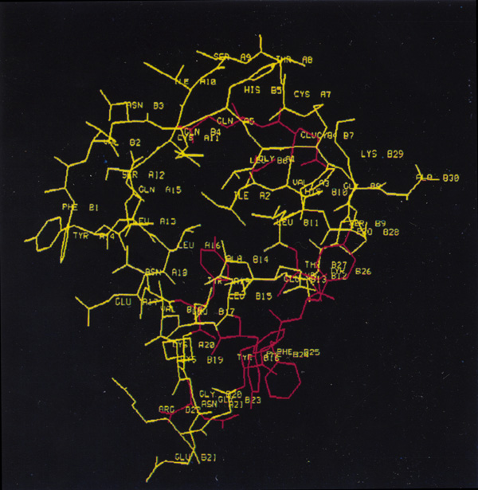
INSULIN
BDC

Slide 47
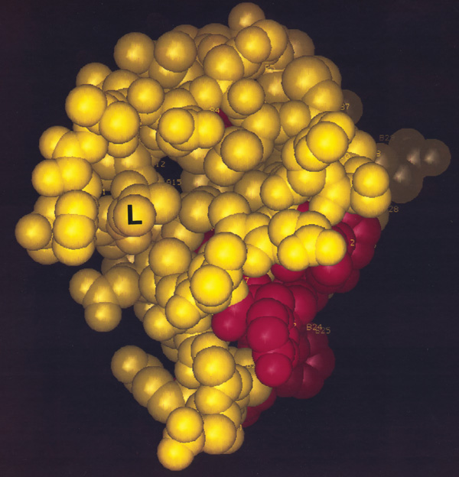
Insulin Autoantibodies:
A Chain L13
Insulin
Receptor
Binding
Region
BDC

Slide 48
PERCENT
Mature high-affinity immune responses to (pro)insulin anticipate the autoimmune cascade that leads to type 1 diabetes. Achenbach et al, J.Clin Invest 2004, 114:589

Slide 49
NOD Balb/c C57/Bl6
Yu et al. PNAS: 97:1701-1706, 2,000
BDC

Slide 50
Normal Controls New Onset Patients
Yu et al. PNAS: 97:1701-1706, 2,000

Slide 51
0.001
0
0.005
0.004
0.009
0.006
0.010
0.008
0.003
Yu et al. PNAS: 97:1701-1706, 2,000

Slide 52
The Levels of mIAA in Prediabetic Children
DM
DM
DM
DM
DM
Yu et al. PNAS: 97:1701-1706, 2,000
BDC

Slide 53
IAA (+) at 8wks
IAA (+) at 20wks or later
IAA (+) at 8wks
IAA (+) at 20wks or later
>
Yu et al. PNAS: 97:1701-1706, 2,000

Slide 54
Age Insulin Autoantibodies first Appeared
P<.001
BDC

Slide 55
Rapid induction of Insulin Autoantibodies by Insulin B:9-23 peptide immunization in Normal BALB/c mice
IAA (index)
10
1
0.1
0.01
0.001
3
4
5
6
7
8
9
10
11
12
13
weeks
B:9-23+ IFA
B:9-23+ IFA
BDC

Slide 56
Dynamic Changes GAD65 Autoantibody epitope Specificities…
Schlosser et al, Diabetologia 48:922, 2005
Analysis competition with recombinant monoclonals to GAD of prediabetic children.
-- No difference epitopes initial sample
-- High risk children emergence of antibodies to conformational N-terminus and middle region
--For high risk but not low risk children binding to N-terminus and middle region increases

Slide 57
Domains/Splice Variants
ICA512
LUMINAL DOMAIN
CYTOPLASMIC
1
576
979
PTP domain
577-600
Transmembrane
Mini:930-978
1
ICA512
979
256
979
ICA512bdc
556
630
Alternative Splice minus 557 to 629 (73 aa)
BDC

Slide 58
ICA512 (IA2) Fragments
Positivity
577 600
DM Transient
F1
1
979
98% 10%
256
556 630
979
ICA512bdc
(100%) (100%)
ICA512ic
605 979
90% 30%
1
TM
760
0% 0%
F2A
256 760
37% 30%
761 928
F2B
54% 10%
Modified from Miao et al. J. Autoimmunity 2002 with F1= Full Length IA-2
BDC

Slide 59
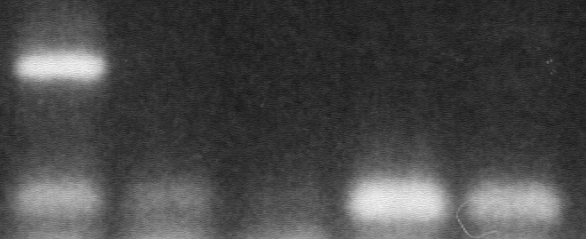
IA-2 mRNA Expression
Pancreas
Thymus 2892
Thymus 3222
Thymus 3236
Thymus 2323
370 bp, Regular mRNA
151 bp, Alternatively Spliced mRNA
Thymus fetal tissues (21-27 weeks), adult pancreas. Pugliese et al.
BDC

Slide 60
GAD and ICA512 Abs:
71,000 DPT Screening Samples
Yu et al, NYAS 2002
BDC

Slide 61
GAD and ICA512 Abs:
71,000 DPT Screening Samples
Yu et al, NYAS 2002
BDC

Slide 62
GAD and ICA512 Abs:
71,000 DPT Screening Samples
Yu et al, NYAS 2002
BDC

Slide 63
DPT-1: Percent GAD or ICA512+
High % Eligible or Diabetic Biochemical Ab+ of Cytoplasmic ICA+ Relatives
Yu et al, Diabetes 50,2001

Slide 64
Percent of 71,148 DPT Screening Samples GAD/ICA512/Cytoplasmic ICA+
95%-/-/-
Yu et al. Diabetes 50: 2001

Slide 65
DAISY Study Population
General population families
Families with type 1 diabetes
screened = 21,000 Diabetic Non-diabetic patients infants
enrolled = 108 high risk - DR3/3 96 15
545 moderate risk - DR3/x, 3/4 607 230
553 low risk 650 415
1,206 All 1,353 660
Rewers et al

Slide 66
DAISY Interviews and Clinical
Interviews: diet
infections
immunizations
allergies
stress
B 3m 6m 9m 1y 15m 2y 3y
Visits
Clinical Visits: blood sample for GAA, IAA, ICA512, ICA
DNA
throat and rectal swabs
saliva sample
Rewers et al
BDC

Slide 67
The Age at Autoantibody Conversion in DAISY AAb+ Siblings
Robles et al,
Clin Immunol
102:217, 2002
Notes:
Not only was the risk to seroconversion increased in the A1, A2 positive subjects but the age at autoantibody positivity appeared to be decreased with 75% developing autoantibodies prior to the age of 2 and 90% developing autoantibodies prior to the age of 3, compared to 50% for individuals without A1, A2.

Slide 68
Percent BabyDiab (Offspring) Autoantibody Positive at age 5 years
HLA and Insulin Gene VNTR
Walter et al, Diabetologia (2003) 46:712-720

Slide 69
Progression to Diabetes vs Number of Autoantibodies
(GAD, ICA512, Insulin)
Percent not Diabetic
Years of Follow-up
3 Ab n = 41 17 8 1
2 Abs n = 44 27 15 4 2 1
1 Abs n = 93 23 14 10 6 4
Verge et al, Diabetes 45:926-933, 1996
BDC

Slide 70
Lack of Progression to DM of ICA+ 0602+ Relatives
Pugliese et a.
BDC

Slide 71
Islet Autoantibodies are rapid responders to stimulus
- rises in GADA immediately post-islet tx
Patient A
Patient B
1000
10
1000
10
x
Antibody units
100
1
100
1
C-peptide (ng/ml)
x
10
0.1
10
0.1
1
0
20
40
60
80
200
400
600
800
1
0
20
40
60
80
200
400
600
800
Days post islet transplant
GADA
IA2A
IA
Patient C
Patient D
1000
10
1000
10
x
100
1
100
1
C-peptide (ng/ml)
x
10
0.1
10
0.1
1
0
20
40
60
80
100
120
140
160
1
0
300
600
900
1200
1800
2400
Days post islet transplant
Bosi et al, Diabetes, 2001

