Slide 1
Chapter 11
Prediction of Type 1A Diabetes:
The Natural History of the Prediabetic Period

Slide 2
TRIGGERING QUESTIONS
Is there an environmental trigger?
Does autoantibody appearance mark triggering?
Time lag between trigger and insulitis?
Time lag between insulitis and beta cell killing?
“Best Model”
?Kilham Rat Virus (Multiple Other viruses)
ACTIVATION INNATE IMMUNITY BY VIRUS
SPECIFIC MHC AND SPECIFIC TCR (Mordes et al)
ANTI-INFLAMMATORY PREVENTS (Zipris et al)

Slide 3
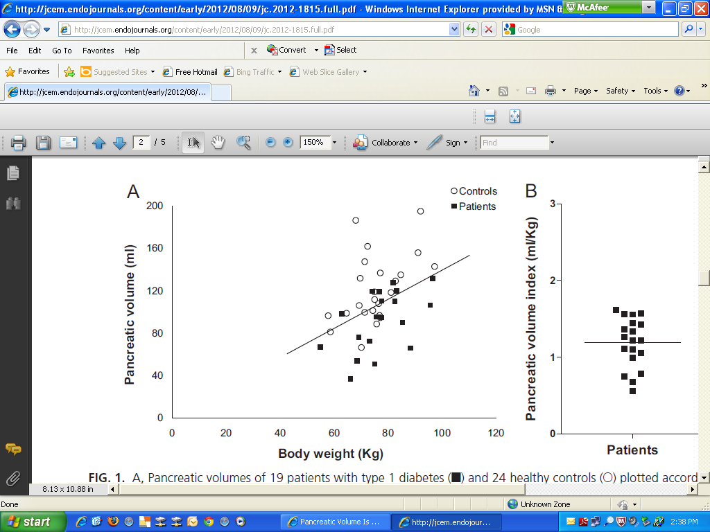
Williams et al: Pancreatic Volume is Reduced in Adult Patients with Recently Diagnosed Type 1 Diabetes JCEM 2012, 97

Slide 4
“Stages” in Development of Type 1A Diabetes
(?Precipitating Event)
Genetic
Predisposition
Overt
immunologic
abnormalities
Progressive
loss insulin
release
Beta cell mass
Normal insulin
release
Overt
diabetes
Glucose
normal
C-peptide
present
Minimal
C-peptide
Age (years)
Eisenbarth 2012
Notes:
4

Slide 5
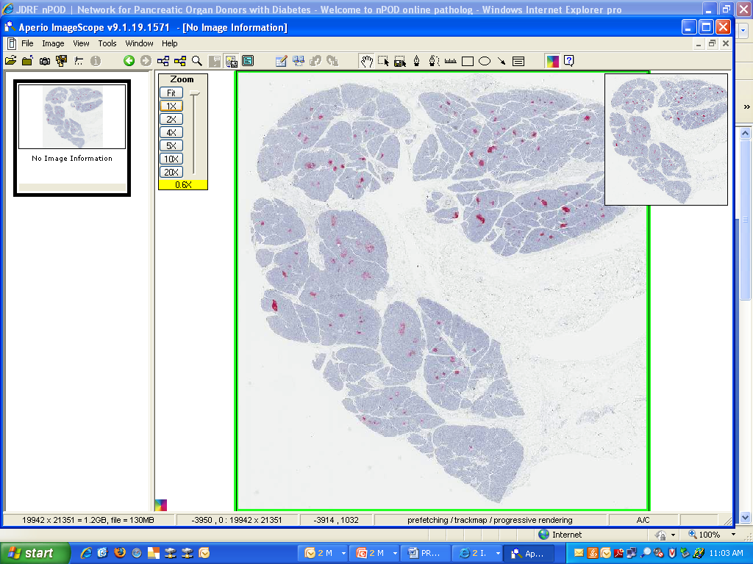
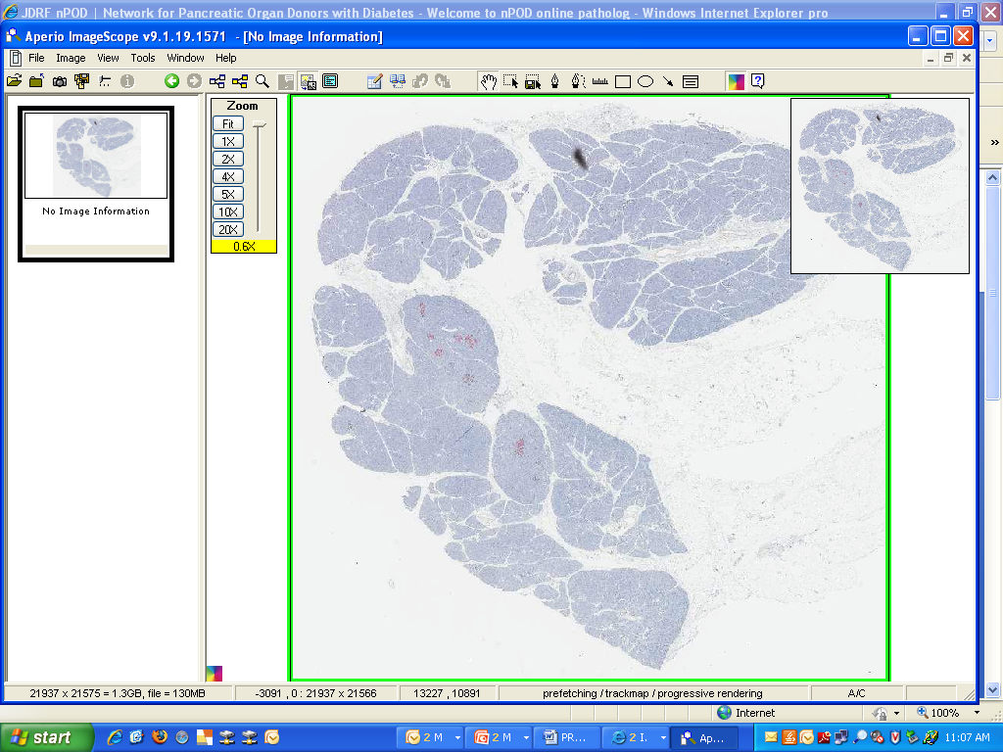
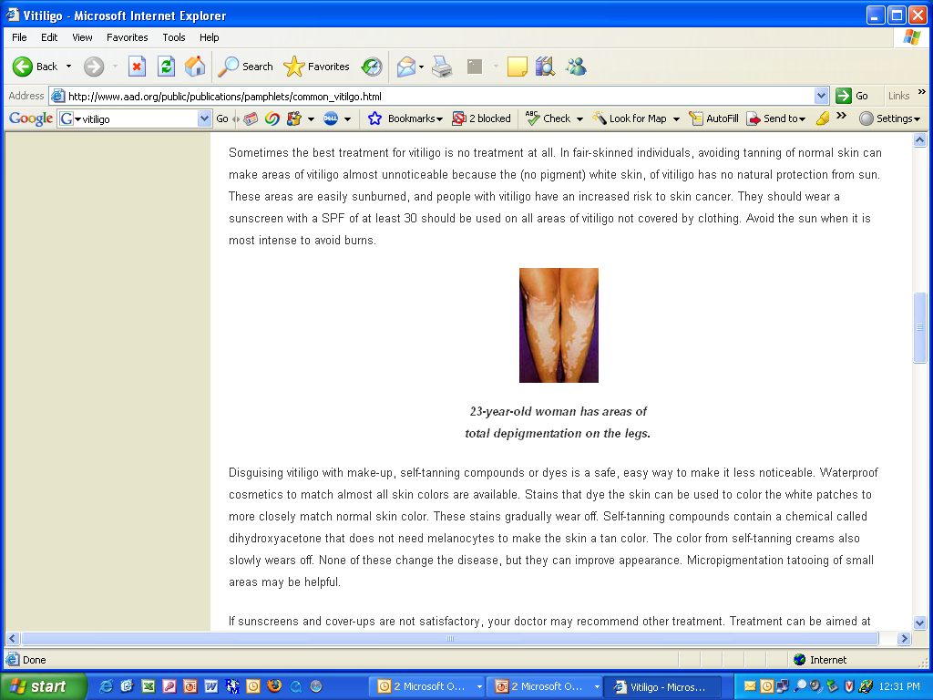
nPOD 6052-02 Tail: 12 yo 1 year diabetes
-Lobular Pseudoatrophic Islets
Glucagon/anti-CD3 Staining
Insulin and Ki67 Staining

Slide 6
Discordant Triplets at Risk for Diabetes
350
Antibody Positive Initial Test
Antibody Positive
300
250
200
Intravenous Glucose Tolerance Test (IVGTT) 1+3 minute insulin
150
100
50
DM
0
14
16
18
20
21
22
24
27
30
34
35
36
37
38
40
42
43
44
45
46
47
48
49
50
14
15
16
17
18
19
20
21
22
23
Age
Srikanta S. et al, New Engl J Med 308:322-325, 1983

Slide 7
Time Course of Beta Cell Loss
Beta
Cell
Mass
Linear, Chronic Model
Eisenbarth (NEJM 1986, 314:1360)
Age
Beta
Cell
Mass
Benign:Malignant Model
Lafferty (J Aut 1997, 10:261)
Benign
Malignant
Age
Beta
Cell
Mass
Random Loss Model
Palmer (Diabetes 1999, 48:170)
Age

Slide 8
Time Course Beta Cell Loss
Linear: Eisenbarth
NEJM 1986, 314:1360
Prodrome> Acute
Lafferty; J Aut 1997, 10:261
Random:Palmer
Diabetes 1999, 48:170

Slide 9
Stages in Development of Type 1 Diabetes
GENETICALLY AT RISK
MULTIPLE ANTIBODY POSITIVE
LOSS OF FIRST PHASE
INSULIN RESPONSE
BETA CELL MASS
GENETIC
PREDISPOSITION
INSULITIS
BETA CELL INJURY
“PRE”-DIABETES
DIABETES
TIME
NEWLY DIAGNOSED DIABETES
J. Skyler

Slide 10
Sustained beta cell apoptosis in patients with long-standing type 1 diabetes: indirect evidence for islet regeneration?
Meier et al, Diabetologia 2005
% Insulin/Pancreatic Area

Slide 11
“Biochemical” Autoantibody Assays
Insulin
Glutamic Acid Decarboxylase
ICA512 (IA-2)
ZnT8

Slide 12
Non-Radioactive Electrochemiluminescent Insulin Autoantibody Assay
Insulin
Autoantibody
Sulfo-TAG
Labeled Proinsulin
Biotin
Labeled Proinsulin
Streptavidin
Coated plate
Yu et al Diabetes Nov 2011

Slide 13
Progression to Diabetes Among Children Positive for Anti-Islet Autoantibodies
Steck et al Diabetes Care 2011

Slide 14
Steck et al Diabetes Care 2011
R2=.47 p<.0001

Slide 15
R2=.37 P<.0001
Steck et al Diabetes Care 2011

Slide 16
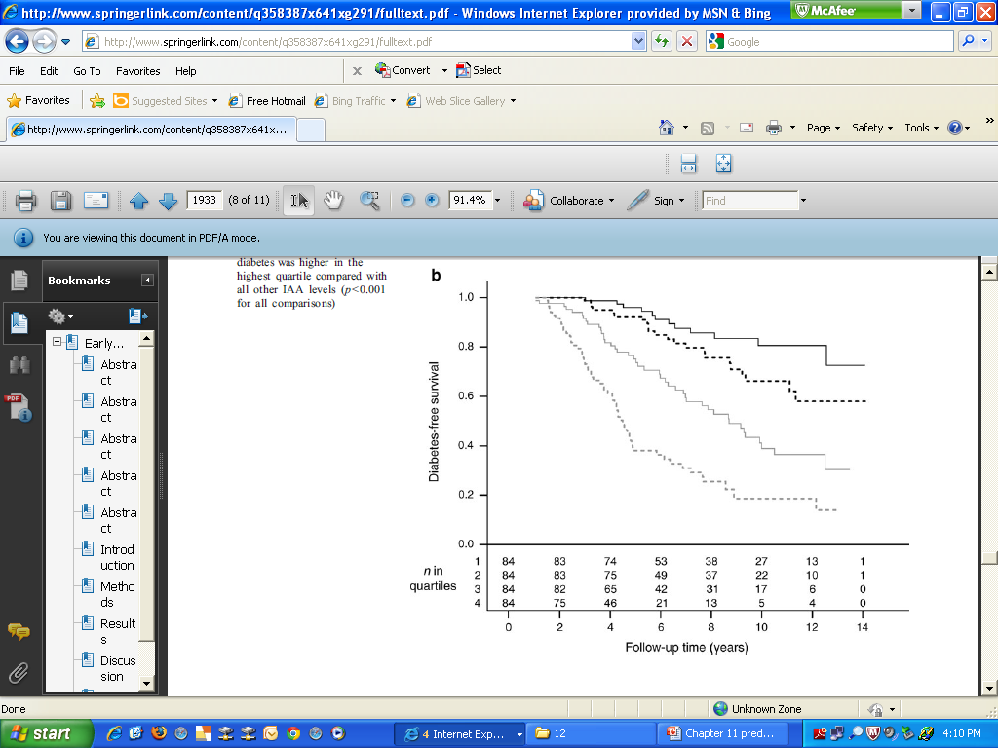
Quartiles of Insulin Autoantibodies Predict Faster Progression to Overt Diabetes
Parikka ….Simell Diabetologia 2012

Slide 17
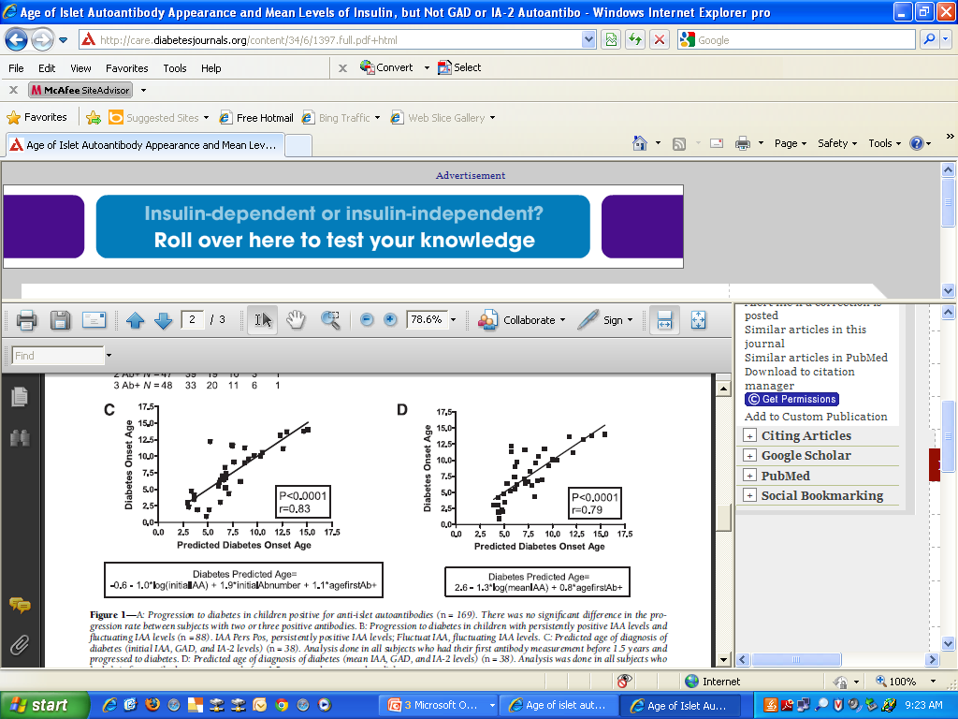
Predicted Onset Age=
2.6-1.3*log(mean IAA) =0.8* age first Ab+
Steck et al Diabetes Care 34:1397–1399, 2011

Slide 18
Steck et al Diabetes Care 2011

Slide 19
LONG TERM PRE-DM WITH MULTIPLE AUTOANTIBODIES
36336-0 DAISY Study
LEVEL Autoantibodies
Diabetes Onset

Slide 20
DPT-1 Ancillary Biochemical Ab
Cytoplasmic ICA Positive (3.4%)
1/2 Negative for GAD/ICA512/Insulin Ab
0.9% = 1 Biochemical Ab
1.1% >=2 Ab
Cytoplasmic ICA Negative (96.6%)
3.3% =1 “Biochemcial Ab
0.3% >=2 Ab
Staging: Only 12% eligible ICA+/Bioch -
Future Trials Likely without ICA

Slide 21
Progression to Diabetes vs Number of Autoantibodies
(GAD, ICA512, Insulin)
Percent not Diabetic
Years of Follow-up
3 Ab n = 41 17 8 1
2 Abs n = 44 27 15 4 2 1
1 Abs n = 93 23 14 10 6 4
Verge et al. Diabetes, 1996;45;926

Slide 22
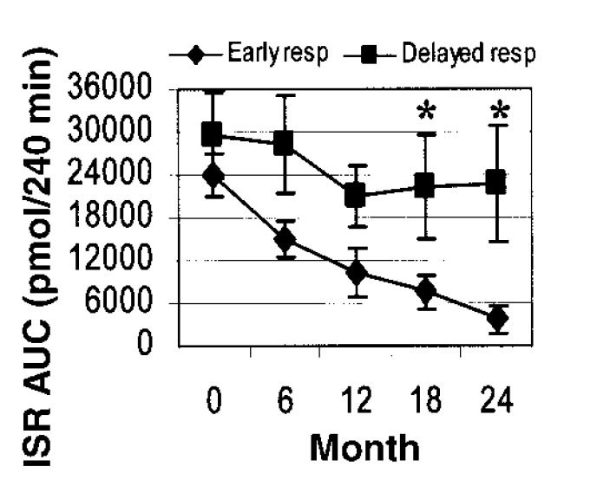
New Onset Type 1 DM: Loss of Insulin Secretion (ISR area(AUC)) related to early (peak<45 min) versus delayed secretion Mixed Meal Steele et al Diabetes 53:26, 2004

Slide 23
Type 1 diabetes risk stratification models based on islet autoantibody characteristics
Model 1
Model 2
Model 3
Model 4
Stratification based on
Stratification based on
Stratification based on
Stratification based on
Number of
islet autoantibodies
(IAA, IA-2A, GADA)
High titre of
IAA (>3rd quart.)
and IA-2A (>1st quart.)
High risk characteristics:
High titre IA-2A (>1st quart.)
and IgG2 or IgG4 IA-2A
and IgG2, IgG3 or IgG4 IAA
Status of
IA-2A and IA-2βA
Category 1
One autoantibody
Category 1
Neither IAA nor IA-2A
at high titre
Category 1
No high risk
characteristic
Category 1
IA-2A negative
Category 2
Any two
autoantibodies
Category 2
One of IAA or IA-2A
at high titre
Category 2
One high risk
characteristic
Category 2
IA-2A positive and
IA-2βA negative
Category 3
All three
autoantibodies
Category 3
Both of IAA and IA-2A
at high titre
Category 3
Any two high risk
characteristics
Category 3
IA-2AβA positive
Category 4
All three high risk
characteristics
Shaded Categories: 10-year diabetes risk >50% (high-risk categories)
Achenbach et al., Diabetologia (2006) 49:2969-2976

Slide 24
Type 1 diabetes risk stratification considering changes in model risk category on follow-up
Model 1
Model 2
Model 3
Model 4
100
80
60
P = 0.02
P < 0.001
P < 0.001
P < 0.001
40
20
0
Diabetes-free survival (%)
100
80
60
P = 0.02
40
20
0
0
2
4
6
8
10
12
0
2
4
6
8
10
12
0
2
4
6
8
10
12
0
2
4
6
8
10
12
Follow up (years)
Stable low-risk category
Changed from high-risk to low-risk category
Stable high-risk category
Changed from low-risk to high-risk category
Achenbach et al., Diabetologia (2006) 49:2969-2976

Slide 25
RISING HbA1c PRECEDES DIABETES
Acute?
Acute?
Stene et al DAISY Study Pediatric Diabetes 7:247-253

Slide 26
NEW ONSET CHILDREN PRESENTING WITH DIABETES
FH = Family History of Diabetes; Control = DM Onset not in DAISY Study
Barker et al. DiabetesCare, 2004; 27:1399-1404.

Slide 27
T1DM- a slowly progressive T-cell mediated autoimmune illness
Genetic
susceptibility
Inciting
Event(s)
“Silent” β
Cell Loss
Diabetes
Onset
“Brittle”
Diabetes
100%
Islet
Cell
Mass
Strong association with MHC class II (DQ in particular)
Other associations much weaker, population dependent-
e.g. insulin VNTR, CD152, other
Infectious agent(s)?- Etiology if true?
Environmental toxin(s)?
Absence of childhood illness?
Combination of factors?
Age of exposure?
What is the “slope” of the β cell loss?
Is recovery possible once process begins?
What underlies the effect of age on slope
of β cell loss?
Why does the β cell destruction typically
occur slowly (in contrast to graft rejection)?
I
We cannot easily/accurately measure islet mass in vivo or ex vivo
No accepted norm for the islet number within a human pancreas
50%
II
III
cell
Mass??
0%
Is β cell mass
completely
lost?
Is β cell loss
exclusively
immune mediated?
Can β cell
regeneration
occur?
Time (years)
David Harlan

Slide 28
Diagnosis of Diabetes ADA
 | NORMAL | IMPAIRED | DIABETES
HbA1c | <6.4 | 5.7-6.4 | >=6.5
FASTING | < 100 mg% (5.6 mM) | 100-125 | >= 126 mg% (7 mM)
ORAL GTT | <140 mg% (7.8 mM) | 140-199 | >=200 mg% (11.1 mM)
Diabetes Care 2004, 27: S5-S10

Slide 29
Gestational Diabetes (>=2 high)
100-g or 75-g Glucose
 | mg/dl | mmol/l
100-g Glucose
Fasting | 95 | 5.3
1-h | 180 | 10
2-h | 155 | 8.6
3-h | 140 | 7.8
75-g Glucose
Fsting | 95 | 5.3
1-h | 180 | 10
2-h | 155 | 8.6

Slide 30
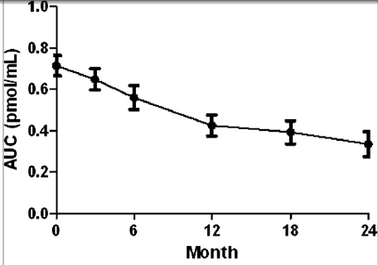
Greenbaum et al Diabetes June 11, 2012
Fall in C-peptide During First 2 Years From Diagnosis: Evidence of at Least Two Distinct Phases From Composite TrialNet Data.

Slide 31
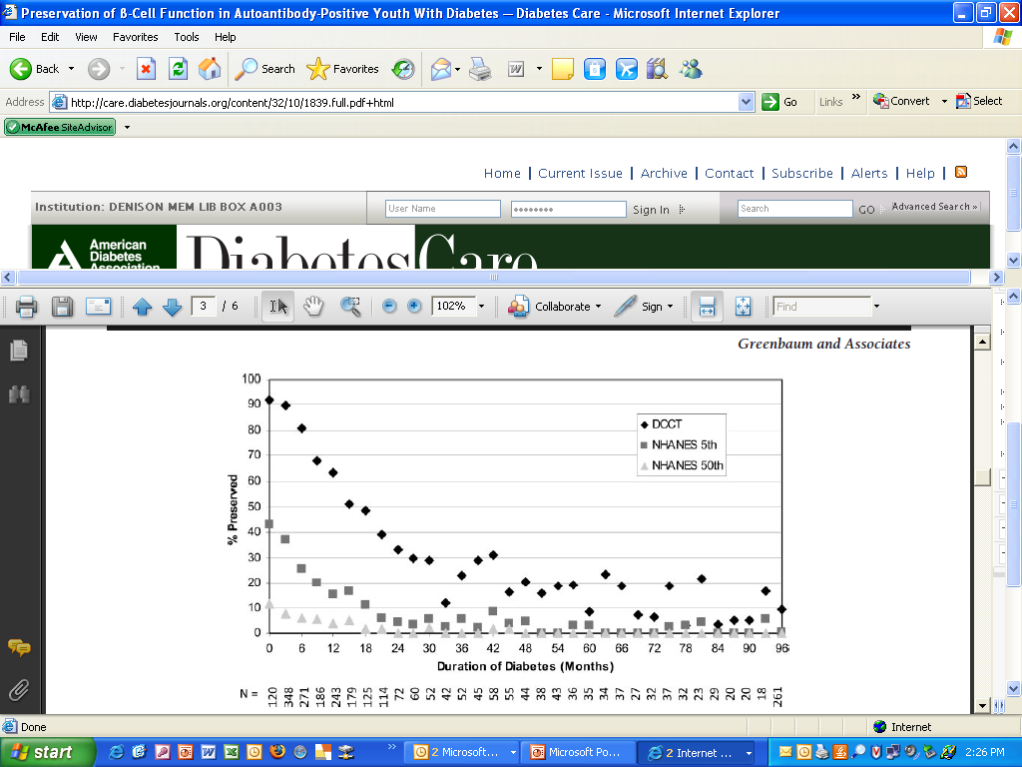
Progressive Loss C-peptide Post Diagnosis (SEARCH Diab Care 2009)
DCCT Fast>=.23ng/ml

Slide 32
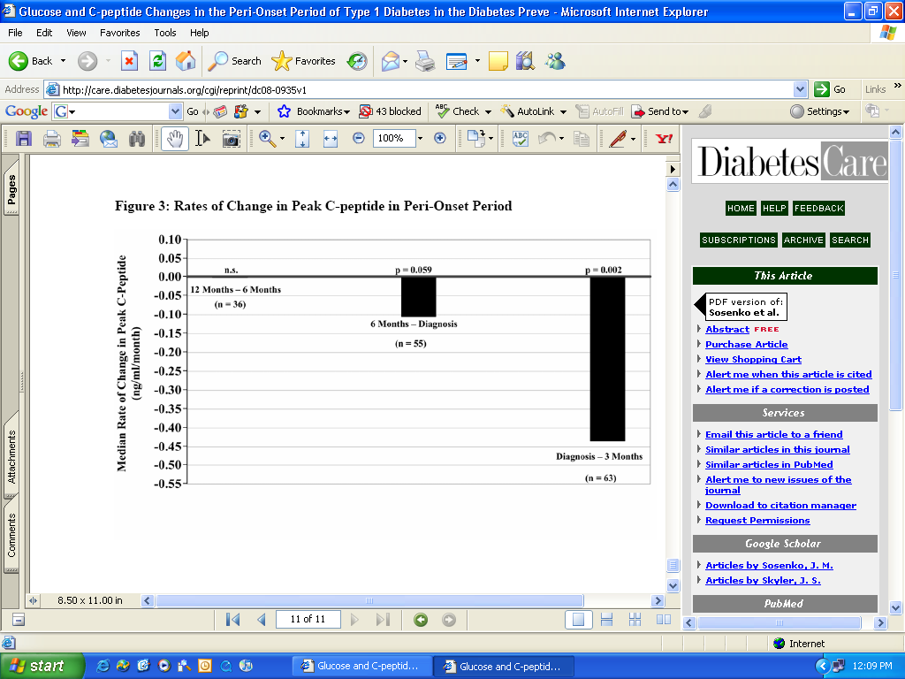
ACCELERATED LOSS OF PEAK C-PEPTIDE AFTER DIAGNOSIS OF TYPE 1A DIABETES (“WAITING” FOR CONFIRMATORY ORAL GLUCOSE TOLERANCE TEST)
Sosenko et al, Diabetes Care August 2008

Slide 33
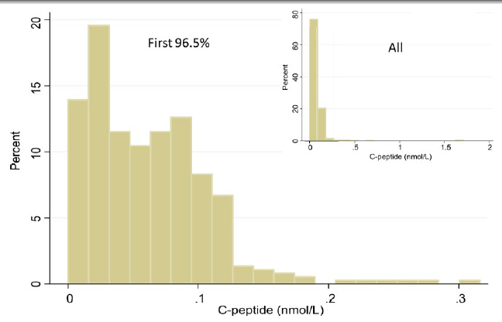
50 Year Joslin Medalist C-Peptide
Times 3 for ng/ml
Keenan et al Diabetes 2010

Slide 34
Gestational Diabetes: Risk at 2 years Type 1 Diabetes by Autoantibodies
ICA, GAD65, ICA512(IA-2)
Sensitivity GAD=63%; Sensitivity 3 Abs=82%
Ziegler et al. Diabetes 1997: 46:1459-67, N=437

Slide 35
LADA: Latent Autoimmune Diabetes Adults in UKPDS study
% GAD +
Insulin by 6 Years
AGE
Turner et al. Lancet 1997;350:1288-93

Slide 36
Caveats of IVGTT Testing

Slide 37
First-phase insulin release during the intravenous glucose tolerance test as a risk factor for type 1 diabetes (DPT)
Chase et al. J. Peds 138,244; 2,001
AGE
<8 8-20 21-30 31-45
BDC

Slide 38
FPIR in pre-diabetic relatives with initial FPIR > 50mU/L
Melbourne Pre-Diabetes Study (Colman PG & Harrison LC)

Slide 40
Insulin Secretion (IVGTT) in Obese Child (BMI 30 to 35) Progressing to Diabetes: Type 1 + Type 2 with Elevated Fasting Insulin

Slide 41
Lack of Progression to DM of ICA+ 0602+ Relatives

Slide 43
Melbourne Data: Dual Parameter Prediction
Time to DM=-.12+1.35ln(IVGTT)-.59ln(IAA)
<2.5 N= 11 5 3 1 0
>2.5 N=70 53 42 32 24 13 6 Proc AAP:110:126-135

Slide 44
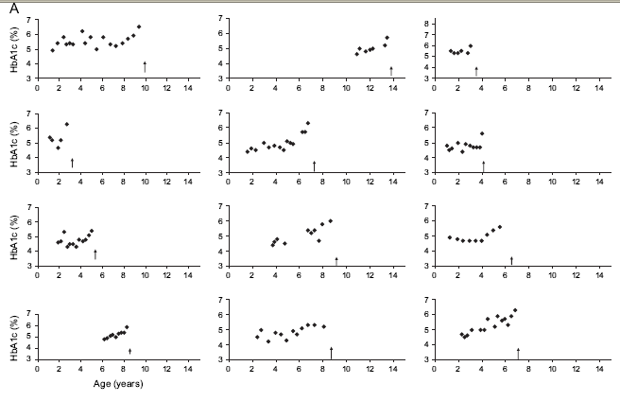
DM
Normal but increasing hemoglobin A1c levels predict progression from islet autoimmunity to overt type 1 diabetes: Diabetes Autoimmunity Study in the Young (DAISY). Stene Pediatr Diabet 2005

Slide 45
Diabetes Autoimmunity Study in the Young
General population cohort
Sibling/offspring cohort
screened = 21,713
enrolled = 293 high risk 72
429 moderate risk 220
347 average - low risk 401
1,069 All 693
relatives 1,491 1,007

Slide 46
DAISY Interviews and Clinical
Interviews: diet
infections
immunizations
allergies
stress
B 3m 6m 9m 1y 15m 2y 3y
Visits
Clinical Visits: blood sample for GAA, IAA, ICA512, ICA
DNA
throat and rectal swabs
saliva sample

Slide 47
Prediction of Autoantibody Positivity and Progression to Type 1 Diabetes: DAISY study
Barker et al. J Clin Endocrinol Metab 89:3896, 2004
Of 1,972= 8.2%
1/3
1/3
1/3
1/3 of Multiple Time+ are Transient (22/(22+24+28)
2/3 High Risk Diabetes

Slide 48


Slide 49
Relatives (SOC) vs. Population (NEC)
Persistent vs. Transient AutoAb
Yu et al. JCEM 85: 2421, 2000

Slide 50
PERCENT
Mature high-affinity immune responses to (pro)insulin anticipate the autoimmune cascade that leads to type 1 diabetes. Achenbach et al, J.Clin Invest 2004, 114:589

Slide 51
Candidate environmental causes of type 1 diabetes
Definite (rare cases)
  congenital rubella 
Putative
  enteroviruses
  rotaviruses
  components of infant diet
    gluten
    cow’s milk

Slide 52
Enteroviruses: Recent Studies

Slide 53
Autoantibody development and enteroviral RNA in a HLA-DR3/4,DQB1*0302 sibling
SD score
ECHO 16
Age [yrs]
EV- EV+ EV- EV+ EV+ EV- EV+ EV+ EV- EV- EV-
DAISY ID 00060

Slide 54
Beta-cell autoimmunity and presence of enteroviral RNA in serum, saliva and stool
Graves PM, DAISY, 1999
Prevalence of EV RNA
3/13 3/13
3/14 6/28

Slide 55
DIPP Protocol
Main Cohort (n=38,000)
Newborns screened for genetic risk
High risk babies followed serially for ICA (n=81)
ICA-positive children randomized to nasal insulin or placebo

Slide 56
Trials to Prevent Type 1 Diabetes
Trialnet/DPT-1
ENDIT
TRIGR
DIPP

Slide 57
Development of islet autoantibodies in
1610 offspring of mothers or fathers with T1D
DR3/4-DQ8
20
DR4/4-DQ8
15
Cumulative Ab frequency (%)
10
Moderate
DR4-DQ8
5
Neutral
Moderate DR3
0
Protective
0
2
4
6
8
Age (years)
Walter et al, Diabetologia 2003 (updated 2004)

Slide 58
Development of islet Abs
- HLA DR-DQ and INS VNTR genotypes
30
DR3/4-DQ8 or 4/4-DQ8
+ INS VNTR I/I
25
20
P = 0.03
Cumulative Ab frequency (%)
DR3/4-DQ8 or 4/4-DQ8
+ INS VNTR I/III or III/III
15
10
5
Other
0
0
2
4
6
8
Age (years)
Walter et al, Diabetologia 2003 (updated 2004)

Slide 59
Development of islet Abs - proband
30
both parents or
parent + sibling
25
20
P < 0.0001
15
Multiple autoantibodies (%)
10
father only
5
P = 0.05
0
mother only
0
2
4
6
8
Age (years)
A. Ziegler

Slide 60
Progression from multiple islet Abs to diabetes
- No effect of HLA DR-DQ or proband
HLA
Proband
High
Both parents or Parent plus sibling
100
Neutral or Protective
100
Mother only
Moderate
Father only
80
80
Type 1 diabetes (%)
60
60
40
40
20
20
0
0
0
2
4
6
8
0
2
4
6
8
Time from first autoantibody positive (years)
A. Ziegler

Slide 61
Islet autoantibody appearance in BABYDIAB offspring
10
Any islet Abs (7.8%)
8
6
Multiple islet Abs (3.7%)
4
Single islet Abs
2
0
0
2
4
6
8
10
A. Ziegler
Age (years)
Hummel et al., Ann Intern Med, June 2004

Slide 62
Progression to multiple Abs is necessary for disease
100
100
80
80
multiple antibodies
60
60
Diabetes (%)
40
40
20
20
Single IAA
0
0
0
0
2
2
4
4
6
6
8
8
Time from first Ab (years)
A. Ziegler
Hummel et al., Ann Intern Med, June 2004

Slide 63
Usual Progression
Insulin
GAD
IA-2
ZnT8
A. Ziegler

Slide 64
First antibody is insulin/proinsulin
8
8
6
6
IAA
4
GADA
4
2
IA2A
2
0
0
2
2
4
4
6
6
8
8
10
0
10
0

Slide 65
IAA affinity is high in children who develop
multiple islet Abs
P<0.0001
10¹²
10¹¹
10¹⁰
10⁹
IAA Affinity (L/mol)
10⁸
10⁷
10⁶
10⁵
10⁴
multiple
Abs
IAA
only
Achenbach, J Clin Invest, 2004
A. Ziegler

Slide 66
IAA affinity is relatively stable during follow-up
10¹²
10¹¹
10¹⁰
10⁹
IAA Affinity (L/mol)
10⁸
10⁷
10⁶
10⁵
10⁴
0
1
2
3
4
5
6
7
8
9
10
11
12
Age (years)
A. Ziegler

Slide 67
Risk for developing islet Abs in relation to
birth autoantibody status in offspring of T1D mothers
10
P = 0.007
8
6
NEG GADA and IA2A at birth
n = 244
% with multiple Abs
Father T1D
4
2
POS GADA or IA2A at birth
n = 476
0
2
4
6
8
10
Age (years)
Koczwara et al, Diabetes 2004
A. Ziegler

