Slide 1
Chapter 3
Animal Models Type 1 Diabetes

Slide 2
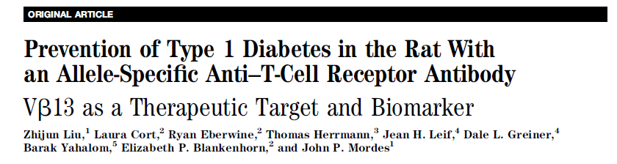
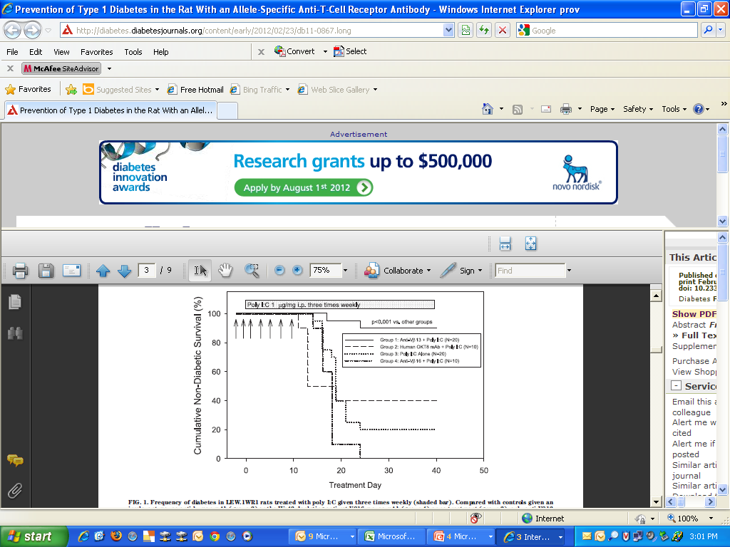
Diabetes 2012

Slide 3
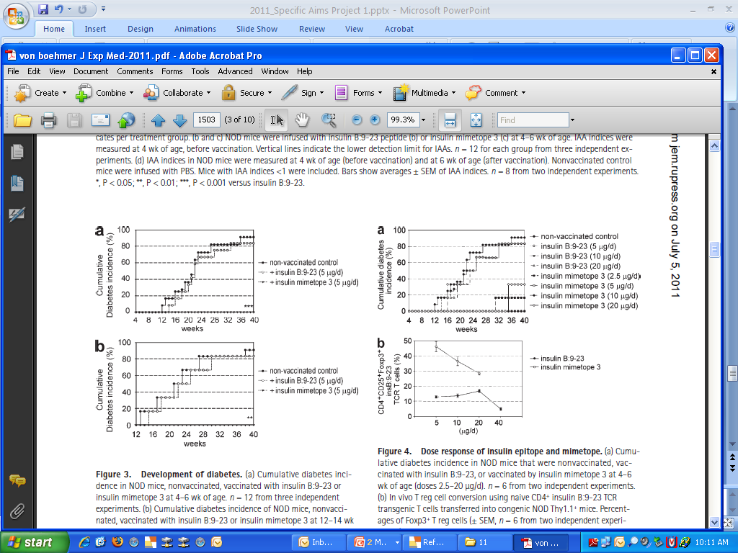
Prevention of type 1 diabetes in mice by tolerogenic vaccination with a strong agonist insulin mimetope
Carolin Daniel... Harald von Boehmer1,2JEM 2011
3-4 wk
vaccination
Register 3 mimotope
12-14 wk vaccination

Slide 4
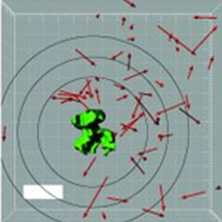
Intravital imaging of CTLs killing islet cells in diabetic mice
Ken Coppieters, Natalie Amirian, Matthias von Herrath
Published in Volume 122, Issue 1
J Clin Invest. 2012; 122(1):119–131
“Random walk” in acinar pancreas of CD8 T cells targeting induced beta cell viral protein (LCMV-GP).
CD8 T cells arrest at post-capillary venules.
Killing may require 6 hour CD8 beta cell contact.

Slide 5
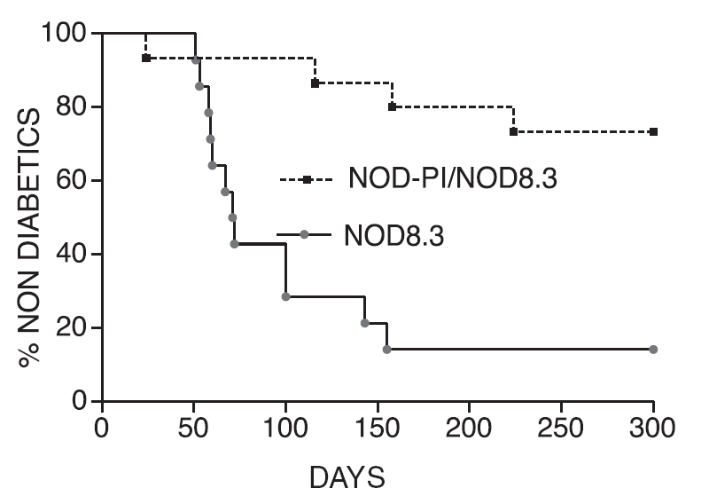
Prevention of Diabetes in TCR Transgenic anti-IGRP₂₀₆₋₂₁₄ (CD8) NOD Mice by tolerizing to proinsulin.
Krishnamurthy et al J. Immunol 2008, 180:4458-4464.

Slide 6
Beta Cell Area
% Ki67+ beta cells
4.8% 2.5% 1.2%
Weeks after anti-CD3 mAb Therapy NOD Mice
Sherry et al, Effects of Autoimmunity and Immune Rx on B-Cell Turnover in Type 1 Diabetes. Diabetes 55:3238-3245

Slide 7
Diabetes Studies Conflict on Power of Spleen Cells:
Jennifer Couzin, Science 24 March 2006, Vol 311: 1694

Slide 8
Turvey et al: Noninvasive imaging of pancreatic inflammation and its reversal in type 1 diabetes JCI 115:2454, 2005
T2(ms)

Slide 9
Mordes et al: LEW.1WR1 Rats Develop Autoimmune Diabetes Spontaneously and in Response to Environmental Perturbation Diabetes 54:2727, 2005
% Diabetic
Rats are MHC Congenic Lewis with RT1 A^{u}B/D^{u}/Cª thus “diabetogenic” class II, and small % insulitis diabetes w/o poly-IC.

Slide 10
Devendra et al: Interferon-alpha as a Mediator of Polyinosinic:Polycytidylic Acid Induce Type 1 Diabetes Diabetes 54:2549, 2005
Serum Interferon post poly-IC (pg/ml)
IFN alpha (pg/ml)
Age of diabetes Onset (weeks)
Age of diabetes onset (weeks)
Poly-IC induction diabetes in RIP-B7.1 mouse model acts through interferon alpha, with antibody blocking, levels correlating (above) and interferon itself inducting DM.

Slide 11
Spontaneous Animal Models
BB rat
Homozygosity Lymphopenia (Ch4), Ian4 gene mutation
RT1-U class II (Ch 20)
Additional Loci (Ch2,18,X)
NOD mouse
Polygenic: class II + class I loci + IL-2 linked polymorphism + >12
Long-EvansTokushima Rat (Komeda Diabetes Prone)
RT1-U MHC
Homozygosity Chromosome 11, Cblb mutation
LEW.1AR1/Ztm-iddm rat
RT1-U MHC for class II B/D, Cu but Aa
Human DQ8 with islet B7-1 Transgene (RIP-B7-1)
B7-1 costimulator (Wen et al.)
BDC-Jun02

Slide 12
NOD Mice
“Families” of Hundreds of Identical Twins
Develop Type 1A-Immune Mediated Diabetes
Are inbred and thus identical at all genetic loci
Genetic loci from other mice can be backcrossed by sequential breeding to fix genes that might influence development of diabetes

Slide 13
Nonobese Diabetic (NOD) Mice
Spontaneously develop autoimmune diabetes
Insulitis at 5 weeks diabetes at 16-30 weeks
Females afflicted more commonly than males
Origin:
outbred
ICR mice
F6
CTS
(cataract
Shionogi)
cataracts
F20
normal fasting
blood glucose
X
NOD
diabetic
high fasting
blood glucose
NON
T. DiLorenzo

Slide 14
Other NOD Characteristics
Deficiency in CD4⁺CD25⁺ regulatory T cells
NK T cell deficiencies (number and function)
Impaired production of IL-4
Defects in FcγRI and FcγRII
I-E^{null}
Lack serum hemolytic complement activity (no C5)
Defective NK cell activity
Defects in differentiation and function of APCs
β2-microglobulin and CTLA-4 are susceptibility genes
T. DiLorenzo

Slide 15
Other Genes
Insulin Gene VNTR Type 1A Diabetes
Protection with greater thymic messenger RNA
AIRE gene APS-I syndrome
Autosomal recessive: 18% Diabetes
Scurfy gene of XPID Syndrome
Neonatal death overwhelming autoimmunity
Ian 4/5 recessive lymphopenia gene BB rat
Cblb recessive autoimmune gene LETL rat
Multiple loci unkown significance

Slide 16
Rat Strains with Spontaneous or Induced type 1 Diabetes
Ellerman et al. Diabetologia 2,000; Whalen et al. Transplant Proc: 199729:1684-5;Lenzen et al. Diabetologia 2001
BDC

Slide 17
The BB Diabetic Rat:
Profound T-Cell Lymphopenia
Jackson, Rassi, Crump, Haynes and Eisenbarth
Diabetes 30: 887-889, 1981
BDC

Slide 18
Intercross Lewis BN Wistar //Backcross
Jackson et al J. Exp Med, 159:1629-1636, 1984
BDC

Slide 19
Immune-Associated Nucleotide-Related: Ian-4(5) gene: BB rat lymphopenia
Rat Chromosome 4, within 290Kb region of lymphopenia locus BB rat
GTP binding protein outer mitochrondrial membrane
Hypothesized to protect from apoptosis
Expressed spleen and thymus
Frameshift mutation BB (450delC)
Ian-4bb last 215 amino acids missing, replaced by 19 other amino acids, including lost membrane binding region
Autosomal recessive determinant severe lymphopenia of BB rat necessary for spontaneous diabetes
Markholst et al, Diabetes 51:1972-1979, 2002
MacMurray et al, Genome Res 2002, 12:1029

Slide 20
Cblb: (Casitas B-lineage lymphoma b)
Autosomal Recessive Diabetogene of Komeda/LETL Rat
Cblb Mice development generalized autoimmunity
LETL/Komeda Rat nonsense mutation, stop codon removing 484 amino acids including leucine zipper and proline rich region
Transgenic Replacement Cblb Prevents Diabetes
Homologous human gene on Chromosome 3
T cells Cblb deficient mice do not require CD28 for activation and Vav1 highly activated independent of CD28 costimulation
Yoikoi et al. Nature Genetics 31:391-394, 2002

Slide 21
The non-obese diabetic (NOD) mouse
An inbred strain of mice with spontaneous development of autoimmune type 1 diabetes
The cumulative incidence of diabetes:
80% in females, 50% in males (at 30 weeks of age)
Both MHC and non-MHC genes are required for development of the disease
H. Ikegami

Slide 22
The NOD mouse: recessive diabetogenic gene within the major histocompatibility complex
Hattori et al. Science 231:733-735, 1986
BDC

Slide 23
PTPN22 in humans, Ptpn8 in NOD
4-1BB
HLA CLASS II
& others?
Idd9.3
VAV3
IL-2
Idd9.2
Idd9.1
HLA
Idd1
Idd18.1
Idd18.2
CTLA-4
(both species)
Idd3
IDDM15
NOD MHC
CLASS II &
other loci
Idd10
IDDM5
IDDM8
IDDM12
Idd5.1
CD101
Idd5.2
NRAMP1
IL2RA
INSULIN
IDDM2
IDDM10
16p
XP11
IDDM4
IDDM17
16q24
Genes in Human & NOD Type 1 Diabetes/2004
Provided by J Todd & L Wicker
For more information visit http://www.t1dbase.org/cgi-bin/welcome.cgi

Slide 24
Low incidence of type 1 diabetes in NOD mice congenic for Idd3 region of chromosome 3 from B6 strain
.B6-Idd3
NOD.B6-chr3
NOD
Chr
1
11
2
12
B6
3
B6
13
4
14
5
15
6
16
7
17
8
18
9
19
10
X
20%
80%
1%
Wicker LS et al. J Exp Med 1994
Lyons PA et al. Genome Res 2000

Slide 25
The NOD mouse and its related strains
NCT
Jcl:ICR
CTS
(outbred)
NOD
NOR
NON
NSY
IIS
ILI
IOI
H. Ikegami

Slide 26
B-cell Mass (mg) NOD vs NOD SCID
Sreenan et al; Diabetes 48:989
NOD SCID
NOD
%DM 0 11% 70%
BDC

Slide 27
Identification of Insulin but Not Glutamic Acid Decarboxylase or IA-2 as Specific Autoantigens of Humoral Autoimmunity in Nonobese Diabetic Mice
Bonifacio et al Diabetes 50:2451-2458, 2001
International Workshop on Lessons From Animal Models for Human Type 1 Diabetes

Slide 28
Blood Sugar levels
IAA levels
GLUCOSE
INSULIN Ab
BY AGE NOD
WEEKS
BDC

Slide 29
Inhibition of NOD Diabetes in Absence of Transplacental Antibodies (Ab)
Greeley et al, Nature Med 8:399, 2002

Slide 30
Autoantibodies/Autoreactive B Cells Contribute to NOD Diabetes
Immunoglobulin knockout prevention NOD DM
Serreze et al, J. Immunol 1998, 161:3912-3918
I-Ag7 on B cells needed for NOD diabetes.
Noorchashm et al, J. Immunol 1999, 163, 743-750
Anit-Insulin VH125 Heavy Chain Increases diabetes in NOD mice.
Hulbert et al, J. Immunol, 2001, 167: 5535-5538
Transplacental autoantibodies accelerate NOD diabetes.
Greeley et al, Nature Medicine, 8:399, 2002
B Cell Deficient Child Developed Type 1A Diabetes
Martin et al, NEJM, 2001, 345:1036-1040
BDC

Slide 31
Reactivity of B:9-23 reactive T cell clones to truncated peptides
B:9-23 S H L V E A L Y L V C G E R G
B:9-23 (15)
B:9-20
B:9-17
B:9-16 (8)
B:9-15
B:9-14
B:10-19
B:15-23
B:14-23
B:13-23 (11)
B:12-23
BDC

Slide 32
Unique properties of the insulin B chain peptide in NOD islet derived CD4 and CD8 T cell clones
1) Insulin Peptide B:9-23
Majority islet CD4 cells recognize
T cells transfer disease
Prevents disease
2) AV13S3, AJ53 or AJ42 Restriction
3) Dual Overlapping Peptides (B:9-16 and B:13-23) Recognized by AV13S3AJ52TCR T Cell Clones
4) Insulin Peptide B:15-23
Recognized by pathogenic CD8 T cell clone from NOD mice
A high percentage of K^{d} CD8 T cells recognize
1) D. Wegmann et al. (1994) Eur J Immunol 24,1853-1857 etc.
2) Eric Simone et al. (1997) Proc Natl Acad Sci USA 94,2518-2521
3) Abiru N. et al.(2000) J Autoimmune 14:231-237
4) F. Susan Wong et al. (1999) Nature Medicine5.9:1026-1031
BDC

Slide 33
B:9-23 Peptide
BDC

Slide 34
Induction
Insulin Autoantibodies/Insulitis/Diabetes
B:9-23 Peptide ----- Insulin Autoantibodies
B:9-23 Peptide + Poly-IC ------ Insulitis
B:9-23 Peptide + Poly-IC + B7.1 Islet -- Diabetes
Moriyama et al. PNAS 99: 5539-5544, 2002

Slide 35
Experimental Autoimmune Diabetes:
H-2^{d} (of Balb/c)+Insulin B:9-23
H-2^{d} | B:9-23 | Poly-IC | Islet B-7.1 | IAA | Insulitis | Diabetes
+ | + | - | - | Yes | No | No
+ | + | + | - | Yes | Yes | No
+ | + | + | + | Yes | Yes | Yes
+ | + | - | + | Yes | Yes | Yes
+ | - | + | + | Low | Yes | Yes
- | + | + | - | No | No | No
Moriyama et al, PNAS 99: 5539-5544, 2002
BDC

Slide 36
Rapid induction of IAA by Insulin B:9-23 peptide Imunization in Normal BALB/c mice
IAA (index)
10
1
0.1
0.01
0.001
3
4
5
6
7
8
9
10
11
12
13
weeks
B:9-23+ IFA
B:9-23+ IFA
BDC
Abiru et al Diabetes 50:1274-1281, 2001

Slide 37
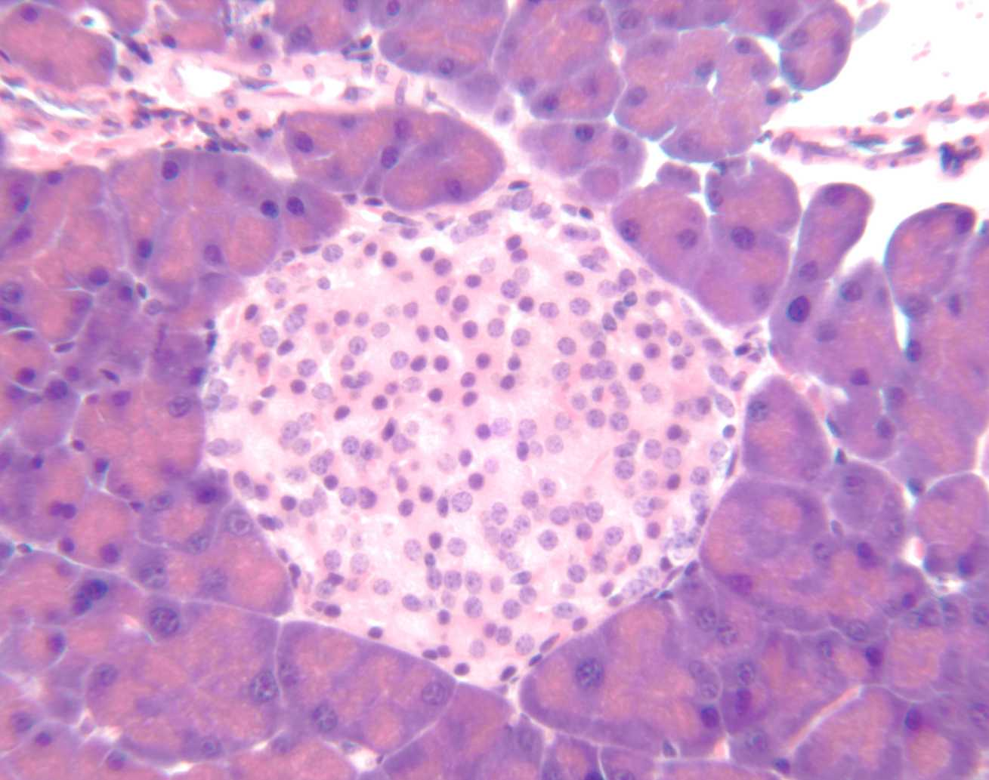
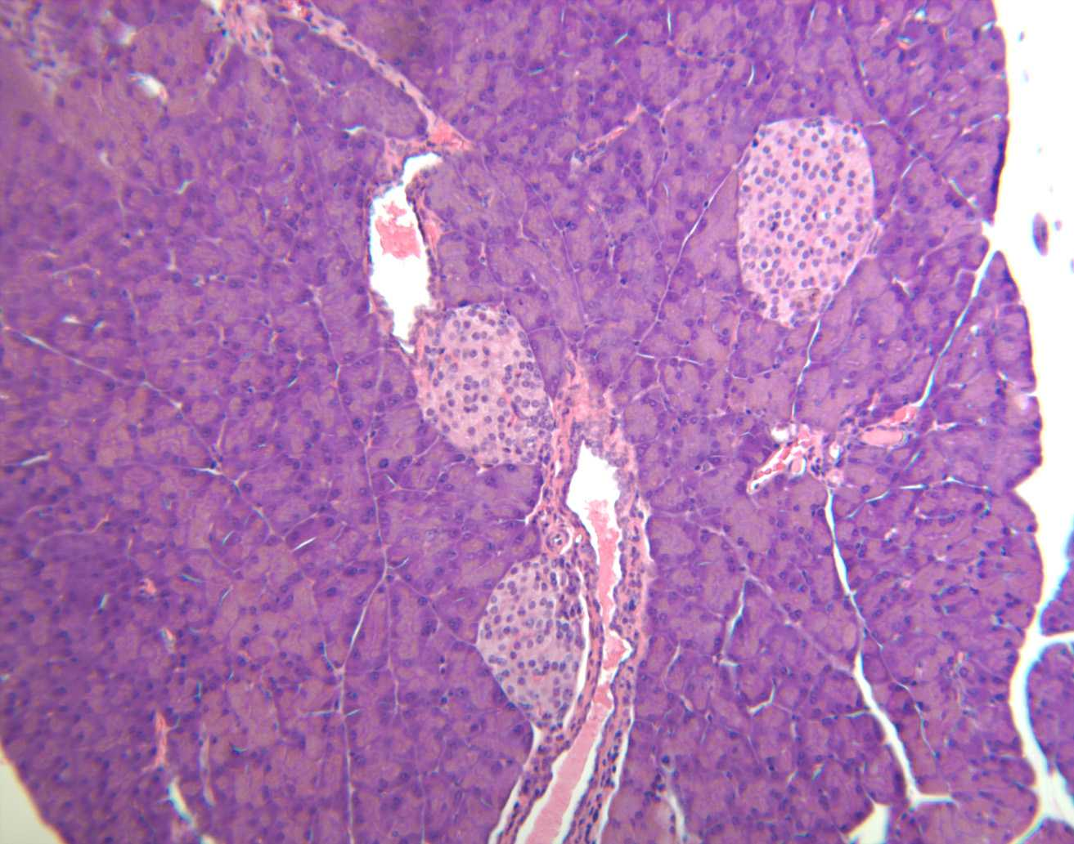
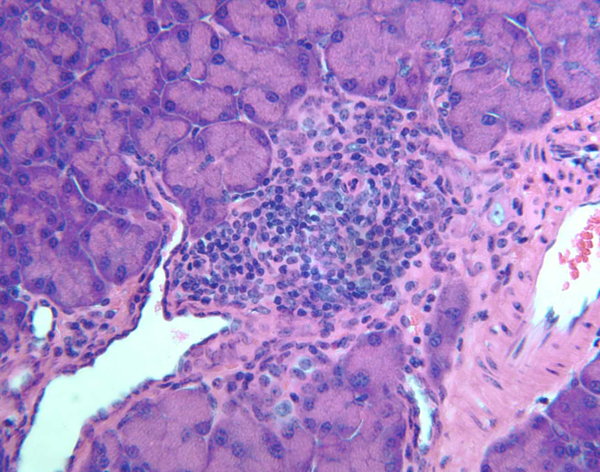
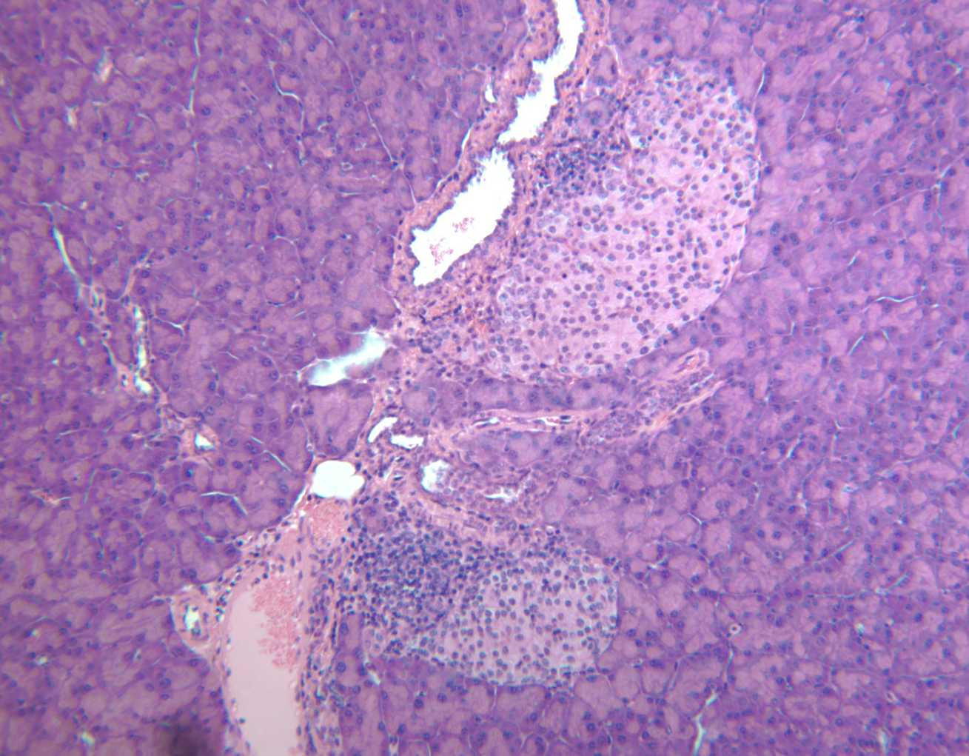
Balb/c Mice: Induction Insulitis Poly-IC plus B:9-23
a
b
Poly-IC or B:9-23
c
d
Poly-IC +B:9-23
PNAS 99:5539-5544

Slide 38
Blood glucose level in B7-1, H-2^{d} mice
B:9-23 in IFA + Poly-IC (DM, 9/9)
TT in IFA or IFA + Poly-IC (DM, 12/16)
(mg/ml)
(mg/ml)
(Weeks of age)
(Weeks of age)
Poly-IC
Poly-IC
B:9-23 in IFA
PNAS 99:5539-5544
TT in IFA or IFA alone

Slide 39
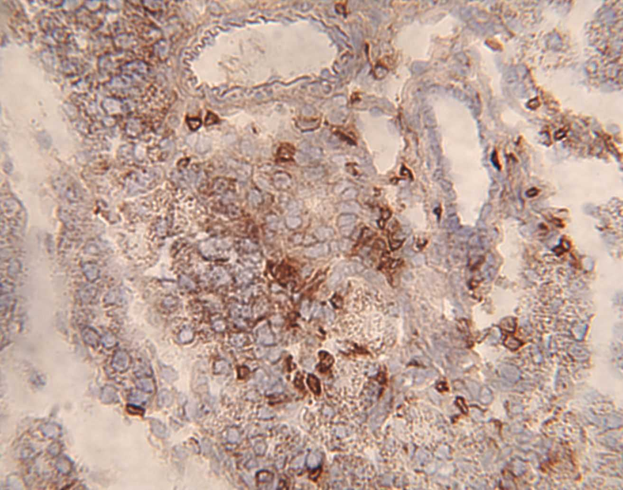
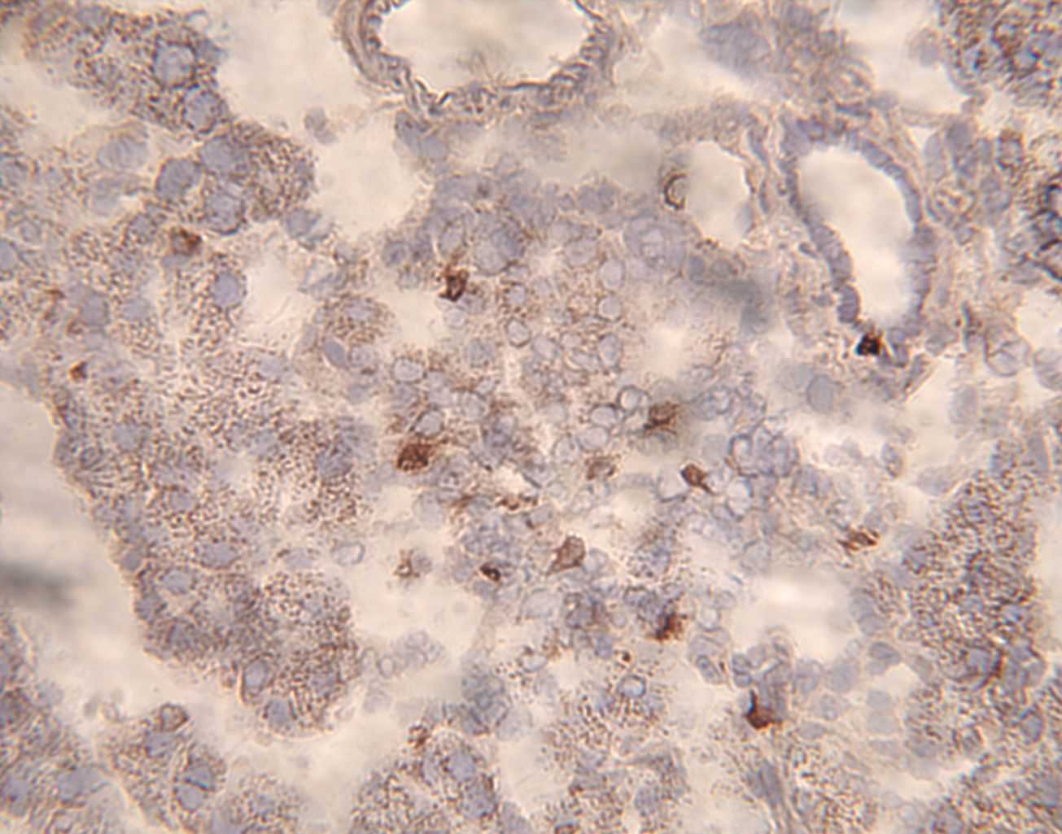
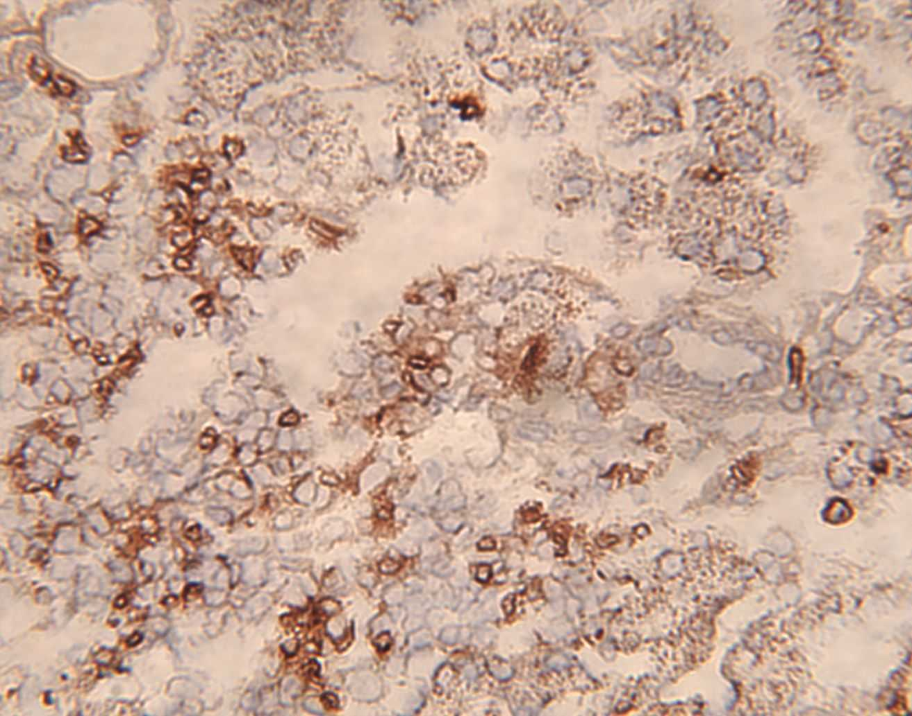
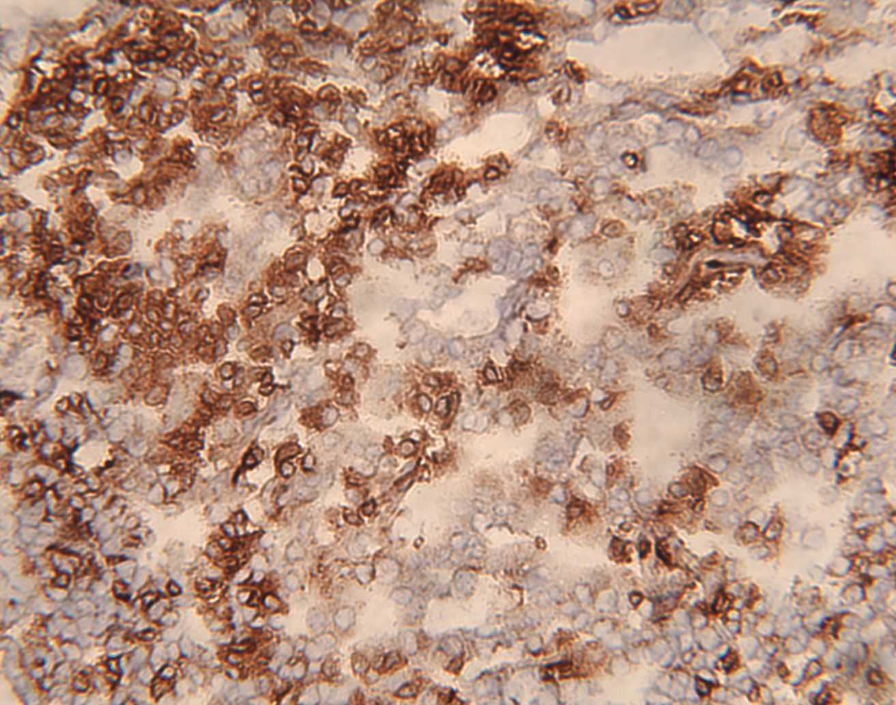
Immunohistochemical Staining in H-2^{d} mice:Immunized with B:9-23+poly-IC
CD4
CD8
B7⁻
B7⁺
PNAS 99:5539-5544

Slide 40
CYTOKINE DEPENDENCY OF NON-Th2 REGULATORY T CELLS
Experimental model
IL-4
IL-10
TGFβ
CD45RB^{hi} T-cell induced colitis
day 3 Thymectomy
Thymectomy-Radiation (rat)
NOD
NKT cells
-
-
+
-
+
+
-
?
-
+
+
?
+
?
?
Bach

Slide 41
Insulin Peptide Induction Anaphylaxis
Liu et al. JCI 2002
Insulin B:9-23 in saline – 7 injections = death NOD
Anaphylaxis dependent upon both
IgG and IgE antibodies
Histamine and Platelet Activating Factor
Anaphylaxis following subcutaneous injection prevented with addition RR to peptide to produce peptide with neutral pI while peptide able to prevent diabetes of NOD mice

Slide 42
Peri-Islet Schwann Cells (pSC) and NOD Mice
Dosch et al Nature Med 2003;9:198-205
Express GFAP and S100 beta
Destroyed NOD mice, TCR transgenic 8.3 (anti-NRP) but not LCMV TCR model
Autoantibodies with mass spec assay
T Cell responses (low level)
T cell clones to GFAP, perinsulitis but no diabetes

Slide 43
Acceleration of type 1 diabetes mellitus in proinsulin 2-deficient mice
Thebault-Baumont et al JCI 111:851, 2003
Preproinsulin 2 gene knockout bred onto NOD mouse accelerates diabetes
-/- mice have greater insulin autoantibodies
(no difference GAD Ab but ?Ab ELISA artifact given workshop data)
Increased insulitis -/- female mice at 8 weeks of age
Preproinsulin 2/1 peptide 88-103 recognized post immunization insulin 2-/- but not +/+ mice (KRGIVDQCCTSICSLY [in A chain])

Slide 44
Normal Incidence of Diabetes in NOD Mice Tolerant to Glutamic Acid Decarboxylase
E. Jaeckel et al.
J Exp. Med 197:1635-1644, 2003
“Our experiments suggest that the protection observed in the GAD-antisense experiments has no immunologic basis.”

Slide 45
PNAS 2003,18:10376
PNAS: 2003, 18:10376

Slide 46
Steptoe et al, JCI 2003:111:1357

Slide 47
Creation of Surviving NOD Mice Lacking Native Insulin Sequence B:9-23
See Makayama et al. Prime role for an insulin epitope in the development of type 1 diabetes in NOD mice Nature 435:220, 2005
Notes:
The method we have tried to do is creating NOD mice lacking native insulin B:9-23 sequence but with mutated insulin for surviving.
Namely, the objective of this study is to determine if complete lack of native insulin with B:9-23 sequence would abrogate development of anti-beta cell autoimmunity.
Original insulin 1knockouts and insulin 2 knockout mice were backcrossed onto NOD mice and we have obtained insulin 1 or 2 knockout NOD mice as shown before.
And also, rat insulin promoter-ligated mutated insulin transgenic NOD mice were created.
And then, these three mice were combined to establish NOD mice lacking insulin 1 and insulin 2 but with insulin B16:Alanine mutation.

Slide 48
Lack of progression to diabetes of NOD mice lacking both insulin native genes.
Ins1-, ins2-: n=
Ins1+, ins2-: n=
25
25
21
23
10
14
2
4
1
1
Life table update 5/19/05
Notes:
Consistent with the absence of insulin-autoantibodies, native insulin-negative mice did not develop diabetes.
The mice bearing insulin 1 gene developed diabetes represented by blue diamonds, on the other hand, none of native insulin negative mice has not developed diabetes.

Slide 49
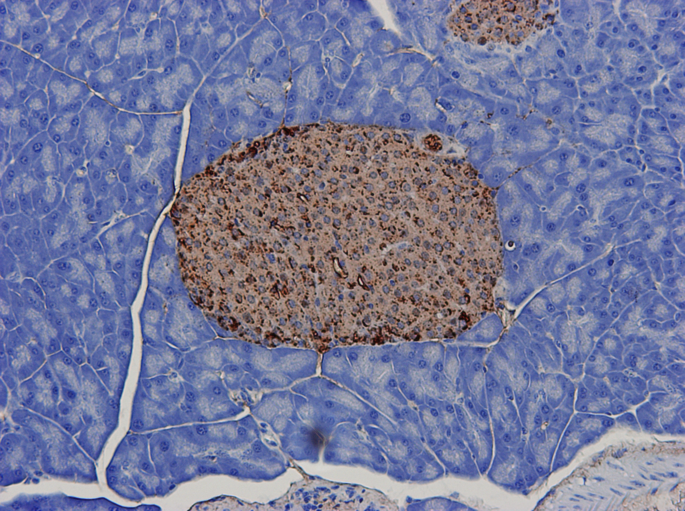
Normal Histology of native insulin-negative NOD mouse with B16:alanine mutated insulin transgene
Insulin Staining
See Makayama et al. Prime role for an insulin epitope in the development of type 1 diabetes in NOD mice Nature 435:220, 2005
Notes:
This slide shows the pancreas histology of native insulin negative NOD mouse.
There is no islet infiltration, very good insulin staining, and normal glucagon staining.
In summary, if NOD mice do not have any native insulin gene, they develop no anti-insulin autoantibodies, no insulitis, and no diabetes.

Slide 50
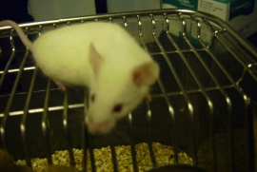

Splenocytes from native insulin-negative mice can induce diabetes into NOD.SCID mice but with delay potentially related to recapitulation attack on islets with native insulin B:9-23 sequence.
No diabetes
Diabetes!!
splenocytes
ins1-/-, ins2-/-, tg+
NOD-SCID
Ins1+/+, ins2+/+
Life table update 5/19/05
Notes:
And finally, we tested the adoptive transfer experiment to see whether splenocytes from native insulin-negative mice can induce diabetes into NOD-SCID mice.
Red square represents the NOD-SCID mice received native insulin-negative NOD splenocytes. Native insulin-negative mice did not develop insulitis and diabetes, but their splenocytes could transfer diabetes into insulin 1+, insulin 2+ NOD-SCID mice, but the time to diabetes induction were longer.

Slide 51
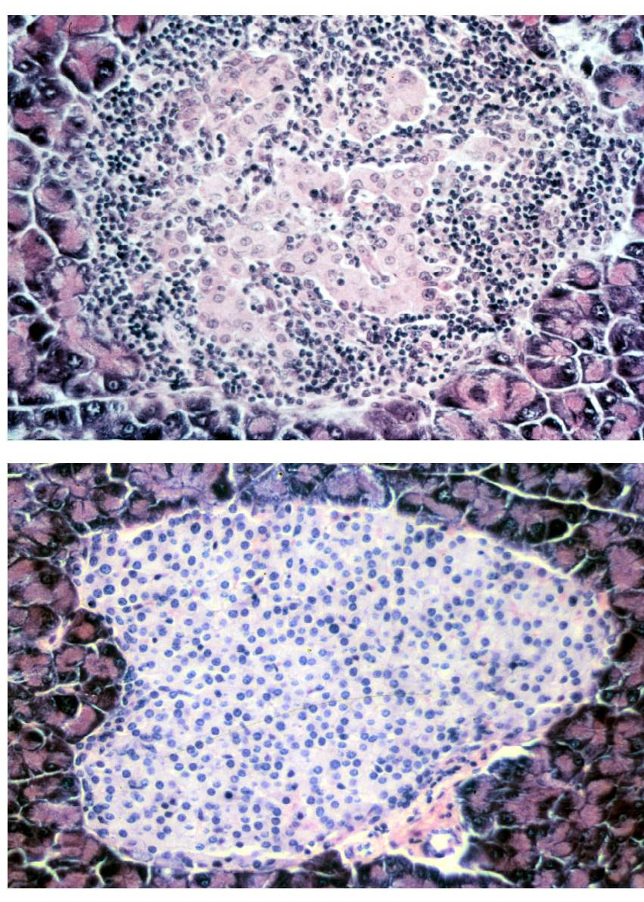
Transfer from NOD-PI mice of hematopoietic stem cells encoding
proinsulin expression by MHC class II⁺ progeny prevents diabetes
1x10³ HSC (lin⁻, SCA-1⁺, c-kit⁺)
i.p. to irradiated recipients at 4 weeks of age
Incidence of diabetes (%)
Recipients of
wild-type NOD
HSCs
Recipients of
NOD-PI HSCs
Age (days)
Steptoe RJ, Ritchie JM, Harrison LC (2003) Transfer of hematopoietic stem cells encoding autoantigen prevents autoimmune diabetes. J Clin Invest 111:1357-1363.
Harrison

