Slide 1
JOSLIN MEDALISTS RANDOM C-PEPTIDE
Modified from Keenan..King et al Diabetes on line Aug 10, 2010 Residual Insulin Production and Pancreatic B Cell Turnover after 50 Years of Diabetes: Joslin Medalist
BDC Controls Rnadom
C-Peptide = 0.3-3.0
? Subject M8 C-pep=.16
Lobular Type A Pathology nPOD
?Subject M9 C-pep=1.66
Type B Pathology nPOD

Slide 2
Gianani et al Dimorphic histopathology of long-standing
childhood-onset diabetes Diabetologia 2010
TYPE B-DM2-CONTORLS
PSEUDOATROPHIC/ TYPE A

Slide 3
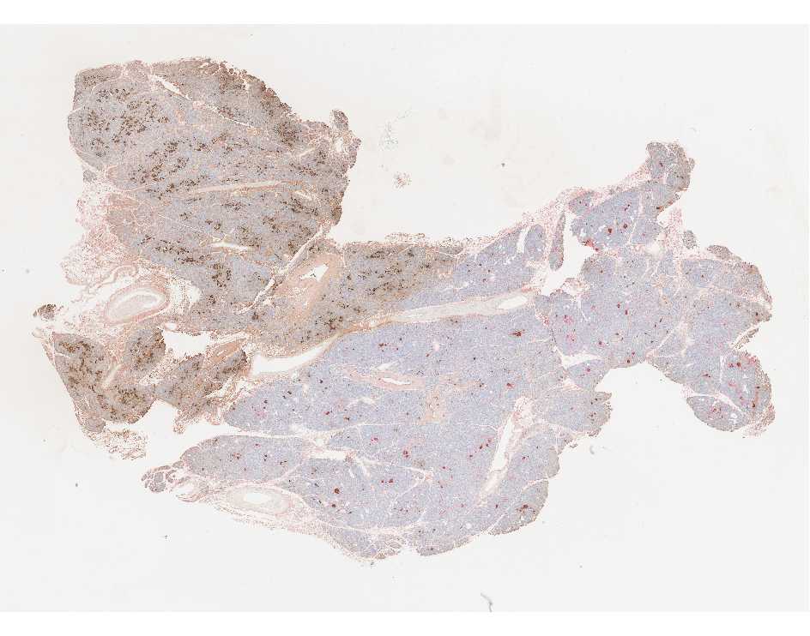
PATTERN A PSEUDOATROPHIC ISLETS (ABSENT BETA CELLS) IN LOBULAR DISTRIBUTION

Slide 4
Clinical Endocrinology 2009
Increased height and weight at 12 months only in siblings developing DM

Slide 5
Type 1 Diabetes
The incidence of childhood type 1 diabetes varies with geographic location, age, sex, ethnicity and time period.
Increase in Type 1 incidence worldwide
SEARCH study “indicates” rise incidence vs. CO registry
Notes:
Diabetes in youth has classically been considered to be 95-99% type 1 DM, classically associated with insulinopenia and autoimmunity. Most epidemiological data on type 1 diabetes in youth are based on a clinical, standard definition that included daily insulin injections instituted at the time of dx. Or within a certain period of time after dx. (2 weeks through 6 months).
Based on this definition, standardized registries of type 1 diabetes in children aged < 14 years have shown that: DM is a common chronic disease of childhood (3rd); the incidence of type 1 DM varies enormously throughout the world (over 400 times), as well as with age, sex, ethnicity and season when diagnosed; that the incidence is steadily increasing worldwide, while so specific factors to account for this increases being identified to date. Due to the lack of such standardized registries in the US. there is limited data to document such an increase in this country. These characteristics of type 1 diabetes incidence provide evidence for major determinants of the disease.

Slide 6
Diabetes in Youth in the U.S.
170,000 patients younger than 20 y
1,500,000 patients with type 1 diabetes
all ages
Number of new patients annually has tripled in the past 20 years
REWERS

Slide 7
Percent Type 1 versus Type 2 Diabetes by Age onset (0-9 versus 10-19)
Dabelea, SEARCH JAMA 2007; 297:2716-2724

Slide 8
Extra 2.9% Dead by Age 30
Laing et al Diabetic Medicine 16, 459-465, 1999

Slide 9
Of Diabetes Deaths 18% male hypo and 6% female not counting epilepsy and dead unattended
Laing et al Diabetic Medicine 16, 466-471, 1999

Slide 10
T1D incidence is rising 3-5% per year Due to environmental cause(s)
Incidence /100,000/ yr
in children aged 0-14
REWERS

Slide 11
Accelerating Incidence Type 1 Diabetes Finland: Lancet 371:1778
Harjutsalo; Sjoberg; Tuomilehto May 2008

Slide 12
Finland Incidence Type 1 DM/100K 1965-1996
Diabetes Care: 22:1066-1070

Slide 13
Finland Type 1 Diabetes Incidence 1965-1996 (32 years) Relative Percent Increase
Diabetes Care: 22:1066-1070

Slide 14
Incidence per 100,000 per year Swiss Males
Schoenle et al. Diabetologia: 2,001, 44:286

Slide 15
Enterovirus Infection Finnish DIPP Study
Hyoty et al Diabetes 49:1314, 2000

Slide 16
Incidence Type 1 Diabetes per 100,000 per year Children <=14
Karvonnen et al., Diabetes Care, 23:1516, 2000

Slide 17
Worldwide Incidence of Type 1 Diabetes
in Children < 14 Years, by Sex
Karvonen et al., Diabetes Care, 23, 2000
Notes:
This figure shown the great variation of incidence of type 1 DM in children < 14 years throughout the world from < 0.1 per 100,000 per year in China, to over 40 in Finland. Based on this figure it was initially talked about a N-S gradient, with lower rates in countries in the southern Europe and higher rates in Scandinavian countries in Northern Europe, but the fact that Sardinia, an Italian island in southern Europe had incidence rates almost equal to those in Finland and much higher than those in the rest of Italy was very much a proof against this hypothesis. Moreover, while there is a male excess in the incidence of childhood type 1 DM in high incidence countries such as UK, Sardinia, Scandinavian countries, there is a slightly female excess in those of low-incidence such as China, Israel and Romania.

Slide 18
Relative Increase in Incidence of Type 1 Diabetes in Children < 14 Years
Change globally: 2.5 % per year (2.32-2.66)
Onkamo et al, Diabetologia 42, 1999
Notes:
Until fairly recent, data on incidence of type 1 diabetes were available for a few populations only, mostly those with high or intermediate risk for the disease. A large number of registries have been established since the mid 1980s worldwide, but the lack of standardized data yield inconsistencies in determining time trends in incidence Most studies using population-based registries have shown an increasing incidence of type 1 diabetes over time while some have shown no trend (CO). Some of the inconsistencies may be attributed to differences in ascertainment over time. Cases need to be collected over a sufficient number of years to detect a temporal change in the incidence. Recently, the results of the World Health Organization Project of Childhood Diabetes (DIAbetes MONdiale) and those of the collaborative research project EURODIAB ACE became available. Both confirmed a continuing significant increasing trend in the incidence of type 1 diabetes in the 1990’s within Europe and worldwide. The incidence is increasing both in low and high incidence populations and it seem that the increase is even higher in countries with intermediate or low risk for the disease (Hungary, China, Slovakia). A recent analysis of data on published incidence trends showed that the incidence of type 1 diabetes is globally increasing by about 2.5 to 3.0% per year.
The rapid increase in incidence cannot be explained by shifts in the frequency of susceptibility genes. Instead, changes in the penetrance of susceptibility genes and/or changes in certain, yet unknown, environmental exposures are more plausible explanations

Slide 19
Incidence of Type 1 Diabetes in Romania, by County
Age < 14 years
Serban, et al, JPEM, 14 2001
Notes:
I thought I’d show you some data that you are not so familiar with, data from a country with low risk for type 1 diabetes, Romania. This figure shows the map of Romania and the incidence of type 1 DM by county. The incidence of type 1 DM in Romania was estimated for 1992-1995 (a 4 –year period) based on a national registry of physician diagnosed diabetes defined as type 1 by the clinical definition mentioned above. Cases were registered prospectively and ascertainment was calculated with capture /recapture method (based on 2 sources) as being 95-97%. The overall incidence was 3.5 per 100,000 per year, and girls had significantly higher rates than boys. What was surprising was the high geographic variability of incidence from counties with rates lower than 2 to counties with rates of about 8. Looking at the 3 main geographical and historical regions (T, M, and M) it was evident that the rates were substantially (although not significantly so) higher in T, the western part of R considered “more developed” , than in M, and M. More so, the highest rates were recorded in the counties were the majority population is of Hungarian ethnic background, close to the incidence of type 1 DM in kids reported in Hungary.

Slide 20
Risk by the age of 20 years

Slide 21
High Risk Groups
Scandinavia - < 5% IDDM cases worldwide
Relatives - only about 10% of the cases
Children - < 40% of the cases
HLA-DR3/4 - about 30-40% of childhood cases

Slide 22
Natural history of type 1 diabetes
Initiators
- virus?
- diet?
Promoters
- genes?
- virus?
- diet ?
Genetic
susceptibility
Clinical
diabetes
Autoimmunity
No autoimmunity
Remission

Slide 23
Genetic Susceptibility to T1 DM

Slide 24
Alleles and Haplotypes in T1 DM Families
J. Noble , HBDI

Slide 25
HLA-Defined T1 DM Risk Groups DAISY, Denver Population, n=21,713

Slide 26
Congenital Rubella Syndrome
30% diabetic usually early IDDM, some NIDDM
incubation period 5-20 yrs
ICA, IAA in up to 80% of those with diabetes
HLA-DR3 or 3/4 in those with diabetes
other autoimmune diseases (thyroid, AD)
molecular mimicry with a 52kD autoantigen
animal model - Syrian hamsters
no diabetes after postnatal infection or MMR vacc.

Slide 27
Causes of congenital rubella syndrome
Agent
rubella virus
Vector
maternal blood
Host
embryo/fetus
HLA-DR3/4
Environment
unimmunized mother

Slide 28
Enteroviruses - recent studies

Slide 29
Richardson, Willcox, Bone, Foulis and Morgan Prevalence of enteroviral capsid protein vp1 immunostaining in pancreatic islets in human Type 1 diabetes Diabetologia(2009) 52:1143-1151

Slide 30
Enterovirus Infection Finnish DIPP Study
Hyoty et al Diabetes 49:1314, 2000

Slide 31
Interferon-alpha Therapy and Type 1 Diabetes Mellitus Fabris et al, Aliment Pharmacol Ther 2003: 18: 549-558
Review: 31 cases type 1 diabetes
Hepatitis C- 3% islet ab+, increase to 7%
9/18 cases type 1 diabetes had anti-islet antibodies (ab+) prior to interferon Rx
23/30 (77%) ab+ at diagnosis
8 cases transient insulin dependence Consider Islet Ab Testing Interferon Rx

Slide 32
Early childhood diet and T1 DM ?

Slide 34
TRIGR 3-yr Follow-up Results Seroconversion to 1+ Autoantibody
p=0.043
n=173

Slide 35
Exposure to cow’s milk and islet autoimmunity
Odds Ratio
Relative Risk
Similar results:
Hummel 2000
Couper 1999
Norris et al., JAMA 1996
Norris, et al., JAMA 2003
N=1,181
Rewers

Slide 36
No association between immunizations and islet autoimmunity Graves et al., DAISY, Diabetes Care 1999
No difference in % vaccinated before 9 months of age
No difference in the median age at the first dose of DTP, Hib, Polio, HepB
No difference in the % receiving HepB at birth
No difference in the median number of doses of Polio, DTP
Similar findings: Hummel et al. BABY-DIAB, Diabetes Care 1996
Rewers
Notes:
18
18

Slide 37
Do environmental agents cause type 1 diabetes?
YES
Can can autoimmune diseases, including T1 DM be prevented by modification of environment ?
YES
Is this the “easiest” way to prevention?
PROBABLY

Slide 38
Where are We Today? Average A1c by Age, 2005-06
Age | Intensive Rx |  | Hvidoere N=1,295^ | Sweden (80% of the nation) | Los Angeles N=1664 | BDC Denver N=3910
 | DCCT N=195 | EDIC N=175
<6 |  |  |  | 7.5 | 8.0 | 7.8
6-12 |  |  |  | 7.9 | 7.8 | 8.2
13-18 | 8.1 | 8.4 | 8.6*^ | 8.4 | 8.4* | 8.6
>18 | 7.1 | 7.9 |  | 8.0 |  | 7.8
*11-18 yrs; ^the original 14 centers, unchanged compared to 1998
REWERS
Notes:
The A1c levels achieved by adolescents participating in DCCT and EDIC are comparable to those reprted recently from H
However, these A1c levels are higher than those achievable in adults and in younger children
Of concern these A1c levels have not improved since 1998, according to the H

Slide 39
T1D patients diagnosed in childhood
live longer
1
1
1975
1975-79
0.9
-
0.9
1970
1970-74
-
0.8
0.8
1965
1965-69
0.7
-
0.7
0.6
0.6
0.5
0.5
0
0
5
5
10
10
15
15
20
20
25
25
30
30
35
35
Duration of diabetes (yrs)
Duration of diabetes (yrs)
Nishmura
R, et al. Diabetes Care 2001
REWERS
Notes:
T 1D patients live longer today. Survival during the initial 25 years of diabetes has been steadily improving in successive cohorts of patients diagnosed since 1965, but is still worse than among people without diabetes. While children diagnosed in the late 60’s were 5-time more likely to die than the general population, the risk is 2-fold in more recent cohorts.

Slide 40
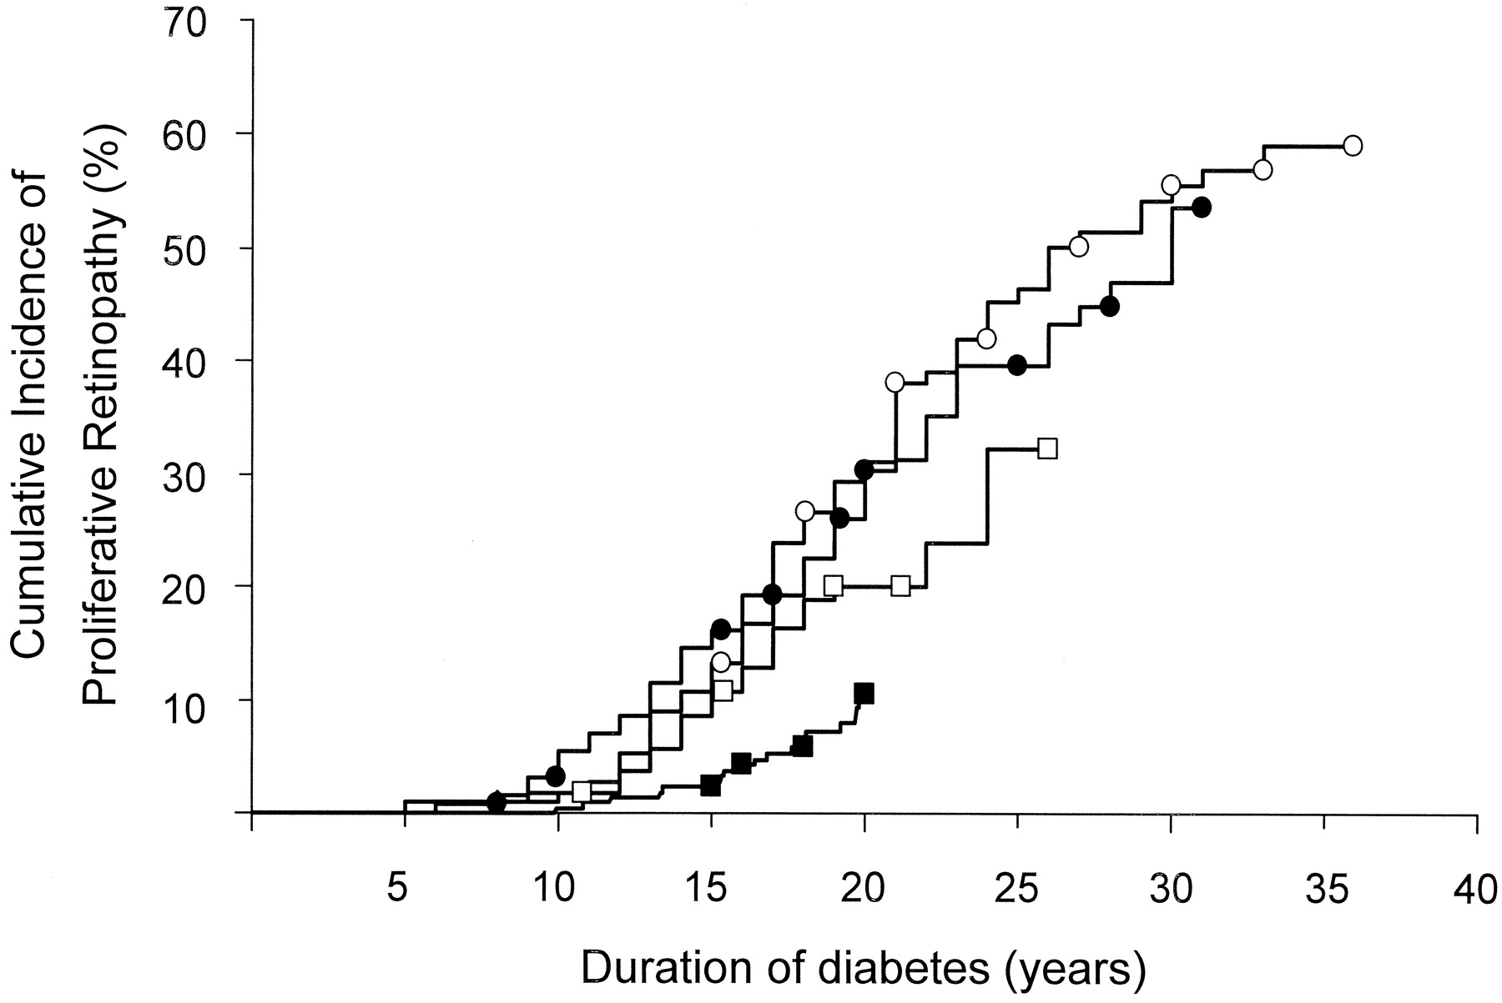
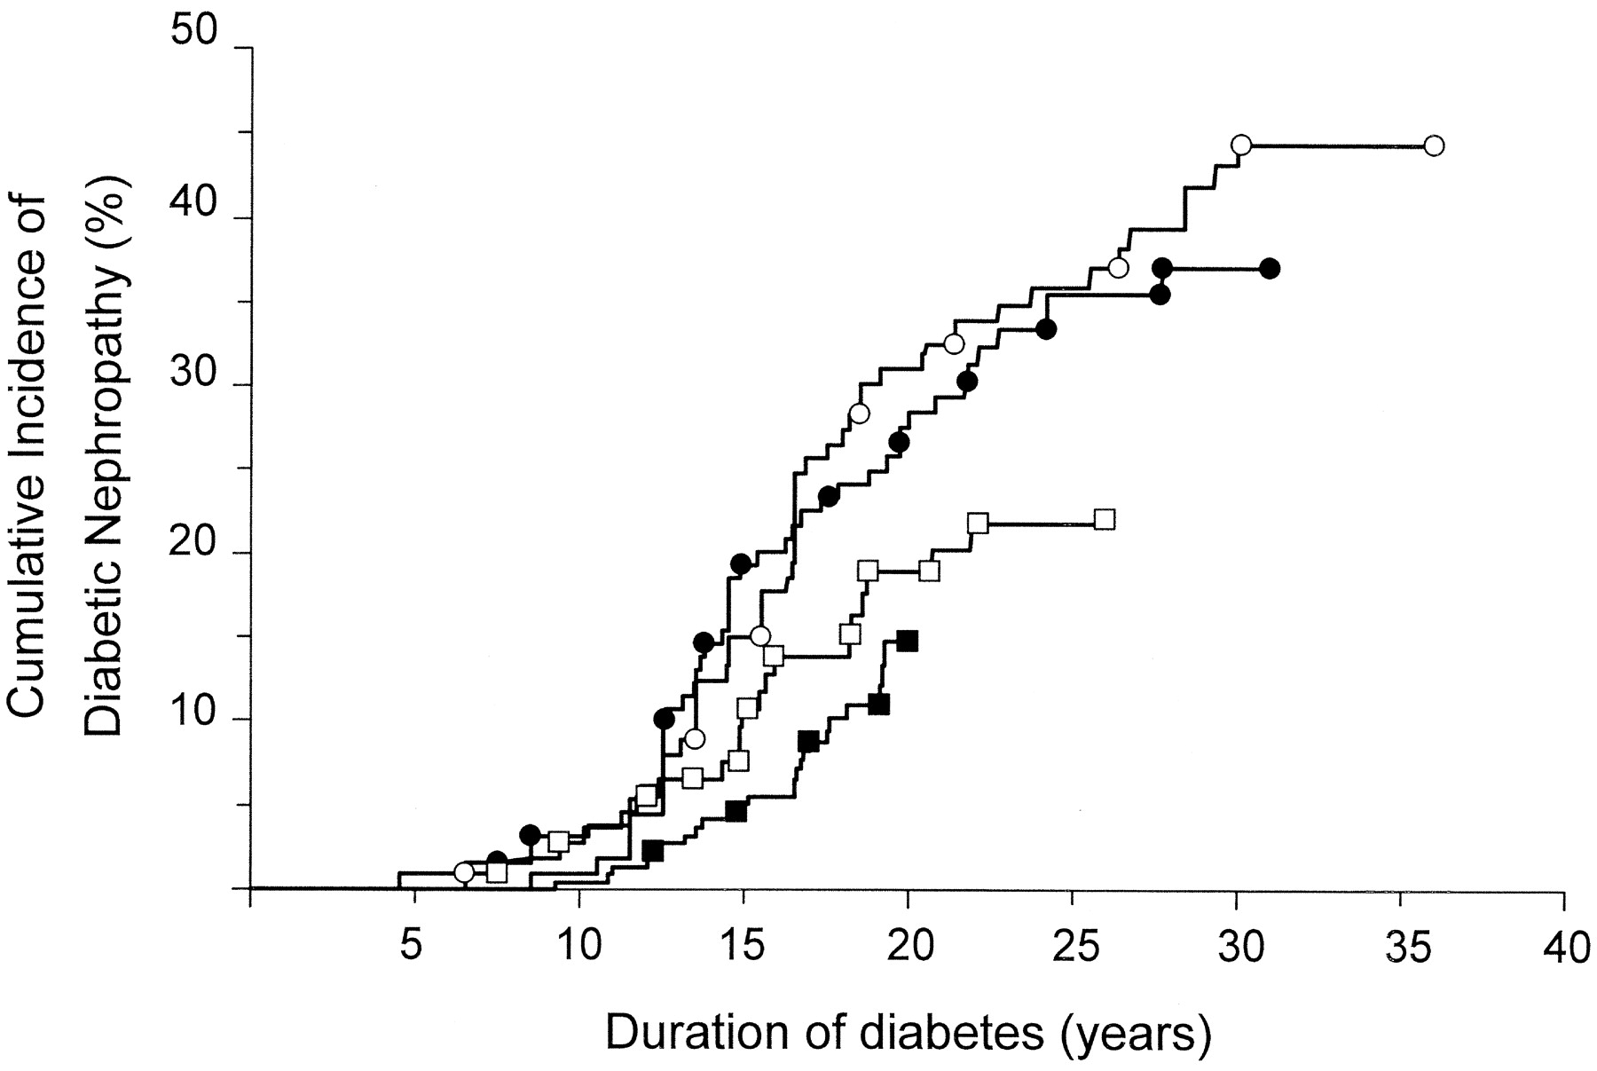
Incidence of microvascular complications is declining
Proliferative diabetic retinopathy
Diabetic nephropathy
1965-69
1965-69
1961-65
1970-74
40
1966-70
1970-74
30
1975-79
1975-79
1971-75
20
1971-75
1966-70
1980-84
1980-84
10
1976-80
1976-80
Hovind P, et al. Diabetes Care 2003
REWERS
Notes:
However, advances made in the area of glycemic and blood pressure control over the past 40 years have lowered the risk of developing proliferative retinopathy or overt nephropathy, as shown by this study from the Steno Diabetes Clinic.

Slide 41
Poor control of hypertension and dyslipidemia in young adult patients with T1D
Hypertension Dyslipidemia
Maahs D, Diabetes Care 2005 Wadwa P, Diabetes Care 2005
REWERS
Notes:
Unfortunately, these goals are largely unmet, even in the CACTI patients, nearly all with excellent access to primary and tertiary care.
One third of the patients had hypertension, but only half of those were well treated and controlled. The other half was either treated, but uncontrolled or not treated at all. Even worse, nearly half of the patients had dyslipidemia, according to the ATP III criteria and very few of these were successfully treated.
These ABC treatment issues should be addressed before we move to interventions targeting novel risk factors, such as adiponectin and markers of inflammation.

Slide 42
Type 2 Diabetes
Apparent increase in 2 diabetes in youth in several populations – especially American Indians, Hispanics and African Americans
Lack of population based studies
Undiagnosed cases
Cases with severe acute symptoms misclassified
Cases reported mainly by pediatric endocrinologists
Notes:
The next part of my talk will focus on type 2 DM in kids, as this is such a “hot” and important topic.
There are several issues to be addressed here:
The apparent increase in type 2 DM in youth that has been reported in several population, mainly in minority children: apparent because of the lack of population based studies/most of the data come from diabetes clinic reports, and apparent because in most of these studies the definition of diabetes type is based on clinical features such as obesity, history of type 2 dm in parents, signs of IR and mainly, lack of insulin requirements for survival.
The other issue is that of undiagnosed cases and rationale and guidelines for screening,
And
Misclassification: cases with acute symptoms misclassified as type 1 DM, but also the reverse, cases that are maybe obese at dx. And not yet insulinopenic being misclassified as type 2 DM, and mistreated.
In any case, these reports that came out throughout the nineties have changed the way “classical childhood diabetes” was thought of, unfolding a much more complex picture.

Slide 43
Reports of Type 2 Diabetes in Youth
Population-based
Pima
Navajo
Cree & Ojibway
NHANES III
School-based
Japan
Clinic-based or Case series
IHS
AI
Cincinnati OH
NHW and AA
Little Rock AK
AA, NHW
Charleston SC
AA
San Diego CA
NHW, H, A, AA
Ventura CA
H
San Antonio TX
H, NHW
A – Asian Americans
AI – American Indians
AA – African Americans
H - Hispanics
NHW – non-Hispanic whites
Notes:
There are few population-based reports of type 2 in youth, mostly North-American: the Pima Indian study in AZ, the Navajo Nation study in AZ nad NM, First Nation AI studies In Manitoba, Canada, and some NHANES III data (diabetes type unknown) plus some studies in Japanese school-age children, a country with a low incidence of type 1 DM. The vast majority of info in the literature comes from case reports of diabetes clinic populations and therefore, probably underestimates the true magnitude of the problem. Notably, there are no population-based studies in US non-Indian populations.

Slide 44
Characteristics of Adolescents at Diagnosis with Type 2 Diabetes
Most are minority children (AA, AI, H)
More girls than boys (F:M ratio = 1.7-3.0)
Mean age: 13 years
> 80% have a history of diabetes in a first degree relative
Obese (Average BMI > 30)
> 60% have acanthosis nigricans
Notes:
All these reports have highlighted the clinical characteristics of type 2 dm diagnosed in youth…

Slide 45
The Changing Face of Diabetes in Youth
Notes:
This figure collapses 3 of such clinic based studies in C (AA, NHW), AK (AA, NHW) and TX (H, NHW), all showing an increasing % of type 2 diabetes (defined based on clinical characteristics) out of all kids dx. With diabetes from 1987 through 1996.

Slide 46
Type 2 by Ethnicity, the Barbara Davis Center Experience
Dabelea
Notes:
This is the BDC experience with type 2 DM in kids, and this figure shows the % of children with type 2 dm out of the total number of kids with dm by ethnicity. Most of them are, as expected, AA and H’s.

Slide 47
Incidence of Type 2 Diabetes in Japanese Children, 1976-1995
6-12
13-15
Age (years)
Kitagawa et. al., Clinical Ped, 37, 1998
Notes:
This figures shows the incidence of type 2 DM in Japanese schoolchildren dx. By glycosuria followed by OGTT, and the dramatic increase in these rates from 1976-1980 to 1991-1995.

Slide 48
Prevalence of Type 2(?) Diabetes in Population-Based Studies -per 1000 [95%CI]-
New Mexico (1991-1992) Navajo Indians 12-19 years
14.1 [0-33.5]
Arizona (1992-1996) Pima Indians 10-14 years
22.3 [11.1-33.5]
Manitoba (1996-1997) Cree & Ojibway Indians 4-19 years
11.1[5.4-18.8]
NHANES III (1988-1994) NHW, AA, H 12-19 years
4.1 [0-8.6]
Fagot-Campagna, et al., J Pediatr,136, 2000
Notes:
This is a brief review of published population-based data on type 2 DM prevalence in youth; the first 3 studies mentioned are based on screening and type 2 dm is clinically defined; the NHANES III data is based on physician dx. And the diabetes type is unknown

Slide 49
Prevalence of Type 2 DM in Pima Indian Youth
Dabelea et al., Diabetologia, 41, 1998
Notes:
Type 2 dm in kids has been shown to be present among the Pima Indian kids since 1967. The Pima Indians in southern AZ have the highest incidence and prevalence of type 2 DM in adults in the world, and virtually all their DM in type 2.
This figure shown the prevalence of type 2 DM in Pima boys and girls aged 5-9, 10-14 and 15-19 years in 3 10-year time periods.
This longitudinal study based on OGTT screening for type 2 dm of all the residents of the Gila River Indian Community has shown that type 2 diabetes is common in Pima kids, that the rates are higher in girls than in boys, they increase with age, but type 2 DM can be seen at any age. In fact the youngest patient with type 2 diabetes was a Pima Indian boy aged 4 years old at dx.
For this study, the type of diabetes was based on clinical characteristics that I am going to show you later, but also on measurements of GAD 65 AB in stored samples from diagnosis.

Slide 50
Recent observations
Possible change in the phenotype of “typical” Type 1 diabetes in youth – to more obese, with less severe clinical onset
Reports of “atypical” diabetes with mixed phenotypes in youth
Notes:
There are also recent observations showing a possible change in the phenotype of typical type 1 dm in youth, as well as reports of atypical dm in youth with mixed or hybrid phenotypes as well as with both signs of AA and IR

Slide 51
Distribution of Body Mass Index by Type of Diabetes
Age 10-19 years at diagnosis
Barbara Davis Center for Childhood Diabetes
Denver, CO
Dabelea
Notes:
The BMI distribution of children aged 10-19 by type of diabetes (with BMI available) who are currently seen at the BDCCD is shown. These data suggest that while the distribution of BMI is clearly higher among cases with apparent type 2 diabetes than among children with type 1a, there is substantial overlap, with 35% of type 2 patients with BMI levels under 28. In addition, there are a number of antibody positive children with type 1a who have BMI levels greater than 25. This may be one of the reasons why such an apparent rapid increase in “type 2 diabetes with obesity” has been noted, since many clinics do not routinely perform autoantibody testing.
---------------------

Slide 52
Incidence of Diabetes in U.S. Children, by ethnicity*
Is it still so?
Pima (4)
NHW (1)
AA (2)
H (1)
AA (3)
1. Kostraba, Epidemiology, 3, 1992
2. Libman, Diabetes Care, 16, 1993
3. Pinhas-Hamiel, J Pediatr, 128,1996
4. Unpublished data
*
NHW, H: 0-17 years
AA Type 1: 0-14 years
AA Type 2: 10-19 years
Pima: 10-19 years
Notes:
As I mentioned before US data on epidemiology of dm in youth are relatively old and not standardized, especially to compare ethnic specific rates. This is what we have: few incidence data on US children of different ethnicities. In the left side of the figure, the incidence of type 1 DM is shown per 100.000 per year in NHW, Hispanics (data from the Colorado registry), and AA (Pittsburgh). On the right side there are incidence data of type 2 DM in AA (Cincinnati) and in Native Americans (Pima Indians of AZ, unpublished data). These are rather old data, and no data on trends are available (except limited data on the Pima Indians, and AA from Pittsburgh).

Slide 53
Types of Childhood Diabetes in Different Ethnic Groups: Is This True?
Whites
American Indians
Other ethnicities
Dabelea
Notes:
Therefore we are left with the question mentioned above. What is the proportion of different types of diabetes among different ethnicities? This is what we think it is, but is it true?

Slide 54
Instructions for obtaining article and slideset:
Early infant feeding and risk of developing type 1 diabetes-associated autoantibodies. Ziegler AG, Schmid S, Huber D, Hummel M, Bonifacio E. JAMA 2003 Oct 1;290(13):1721-8
Go to http://www.biocritique.com/
Sign in or register.
Select the Diabetes Forum from the drop down list.
Click on the Selected Articles link.
In the chronological list, scroll to Oct. 6th, 2003 articles.
Select Early infant feeding and risk of developing type 1 diabetes-associated autoantibodies. Ziegler AG, Schmid S, Huber D, Hummel M, Bonifacio E. JAMA 2003 Oct 1;290(13):1721-8:
The abstract will appear. Choose from many options, including Download Article & Download Slides.
Notes:
Instructions for obtaining article and slideset for:
Early infant feeding and risk of developing type 1 diabetes-associated autoantibodies. Ziegler AG, Schmid S, Huber D, Hummel M, Bonifacio E. JAMA 2003 Oct 1;290(13):1721-8
Go to http://www.biocritique.com/
Sign in or register.
Select the Diabetes Forum from the drop down list.
Click on the Selected Articles link.
In the chronological list, scroll to Oct. 6th, 2003 articles.
Select Early infant feeding and risk of developing type 1 diabetes-associated autoantibodies.
Ziegler AG, Schmid S, Huber D, Hummel M, Bonifacio E
JAMA 2003 Oct 1;290(13):1721-8:
The abstract will appear. Choose from many options, including Download Article & Download Slides.

